Slide 1
Welcome Participants!
All Participant Meeting
March 27, 2019
Notes:
welcome- brooke and heather

Slide 2
Relay is only 9 days away!
Why do you Relay?
Notes:
countdown and why i relay- brooke

Slide 3
Top 3 Fundraisers
Kunal Patel
Megan Mallias
Sarah Scarborough
Notes:
top fundraisers- heather

Slide 4
Each dollar venmoed to @RelayForLife2019 is the equivalent of one entry into the chance drawing. Winner will be chosen at the end of the meeting!
Notes:
venmo challenge- brooke

Slide 5
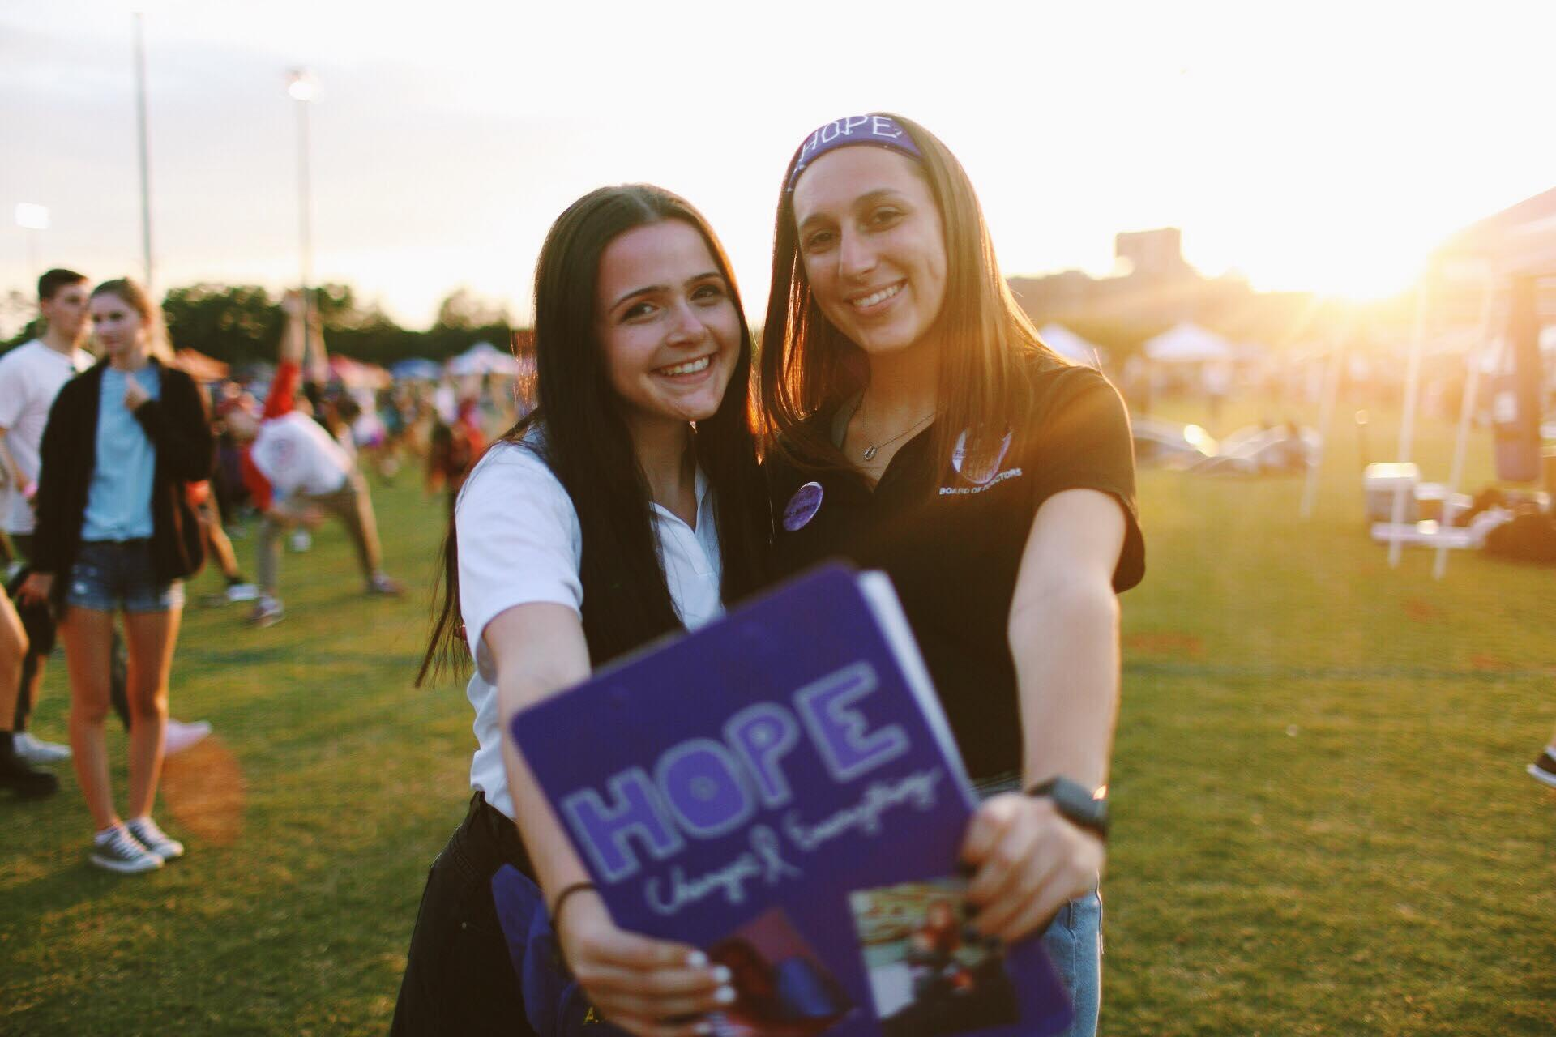
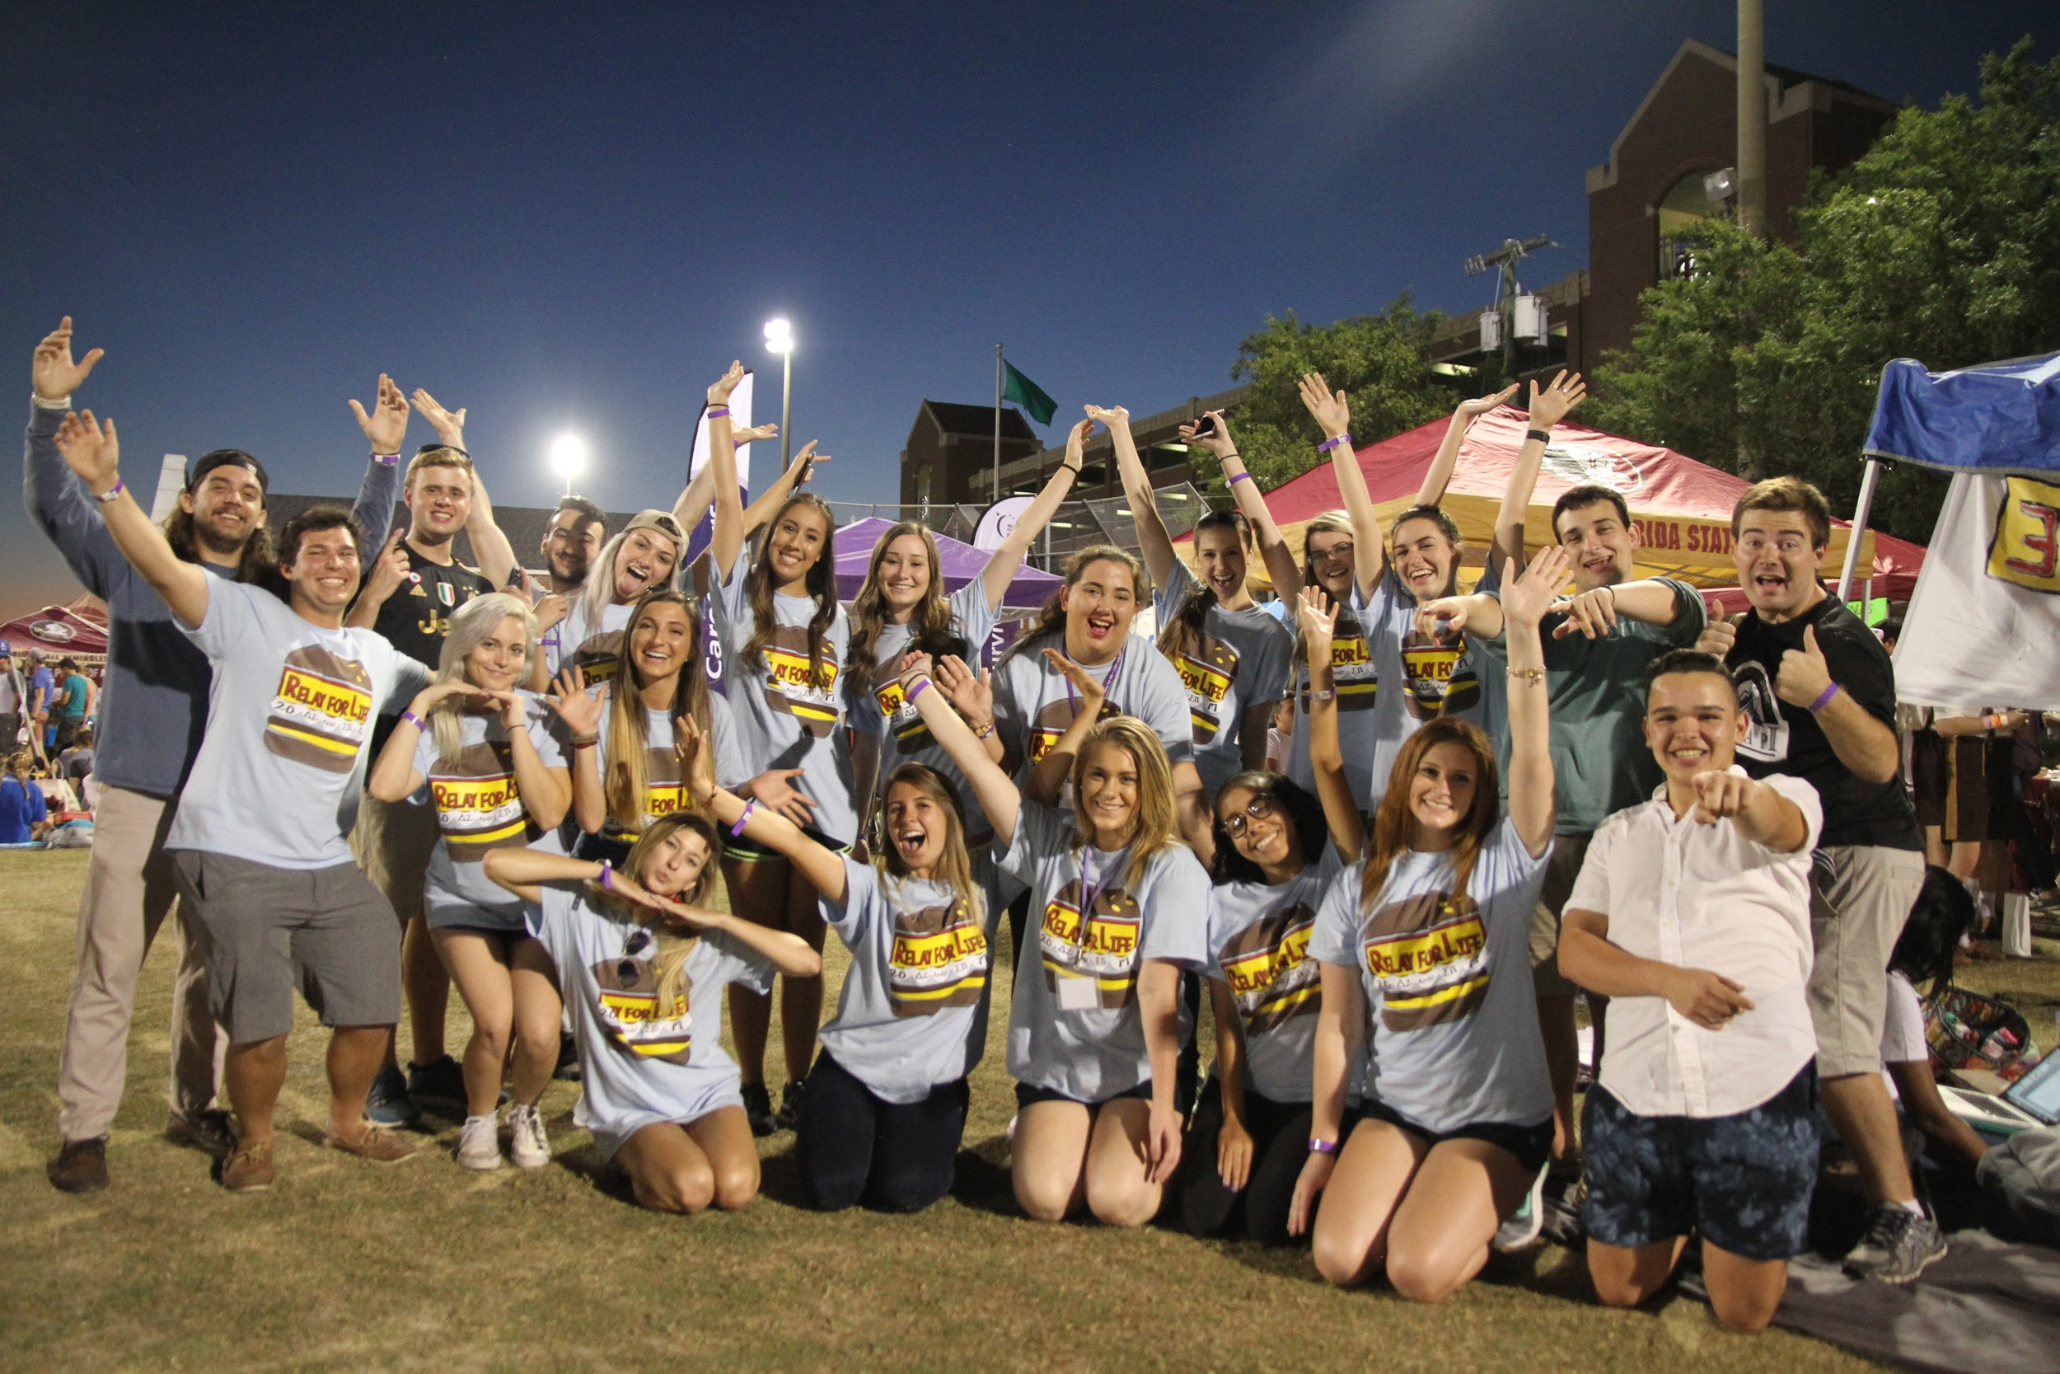
Greek Week 2019, March 25-29, 2019
Monday (3/25): Tabling at the Integration Statue
Panera bagels
Ribbon tying for our reasons Why
Wednesday (3/27): Market Wednesday and All Participant Meeting
Donuts at Market Wednesday
All participant meeting at 7:30pm in HWC3100
Thursday (3/28): Smoothie King Smoothies and Blaze Pizza Share-it Night
Tabling at Integration Statue with smoothies for donors
Friday (3/29): Online Challenge
Greek team to raise the most money will have a tent set up for them when they arrive at the event
Notes:
reagan

Slide 6
Paint the Campus Purple Week
Sunday, March 31: Light up Greek Streets
Monday, April 1: Why I Relay on Landis and Chuy’s Share-it Night
Tuesday, April 2: Fundraising Check-in
Wednesday, April 3: Puppies for a Cure
Thursday, April 4: Last Minute Registration and Maple St Share-it Night
Friday, April 5: Relay For Life 2019
Notes:
PTCPW- alyssa

Slide 7
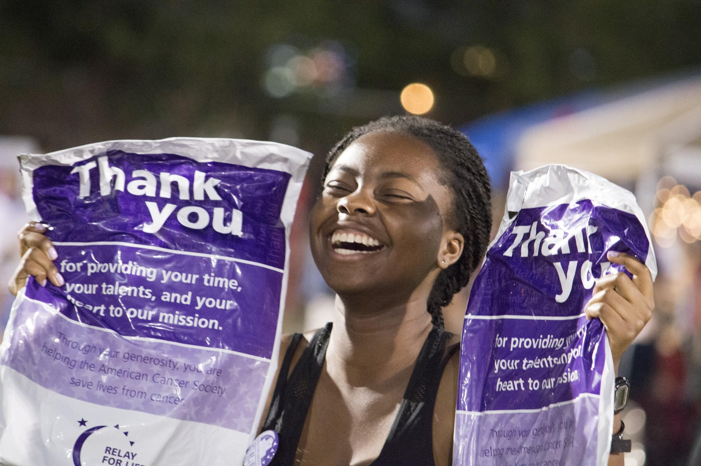
Bank Night
Wednesday, April 3rd in the Globe Dining Room from 7pm to 10pm
Bring any cash/coins to be counted toward your team
We will collect it all, count it, and put it into your teams account
Team Captains will pick up team captain & Hope club shirts
Ask any last minute questions you may have for the night of!
Notes:
bank night- alyssa

Slide 8
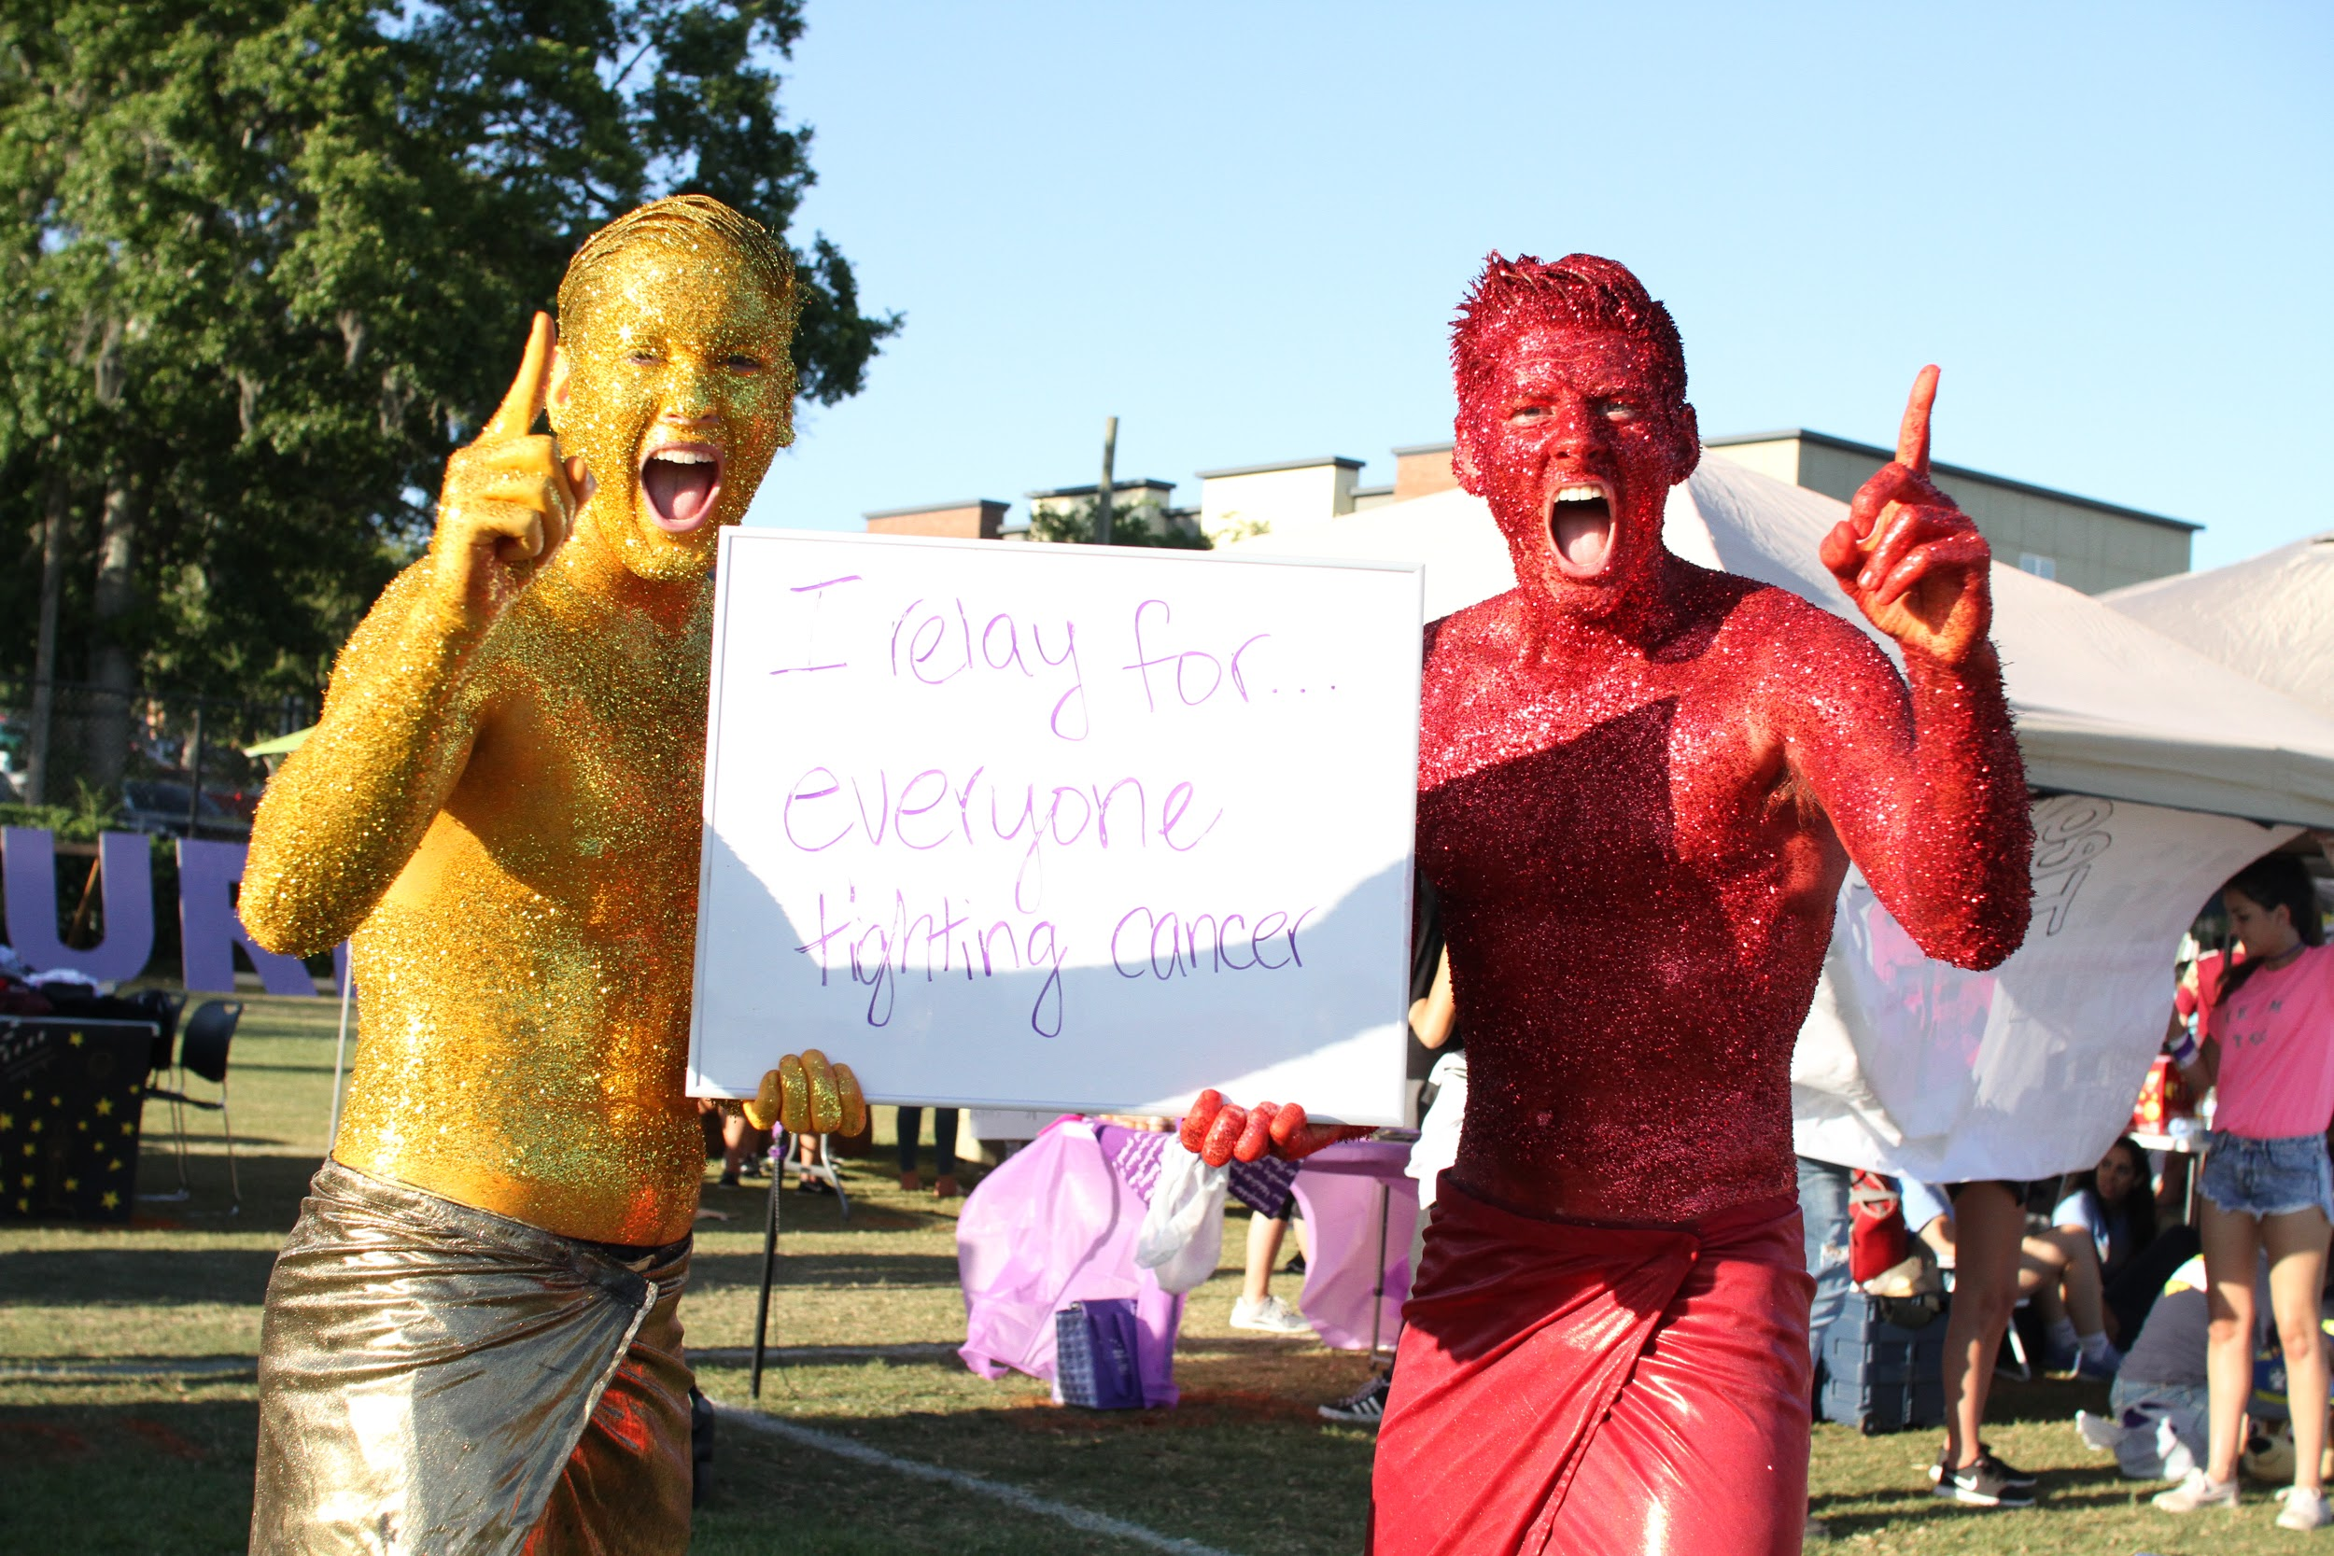
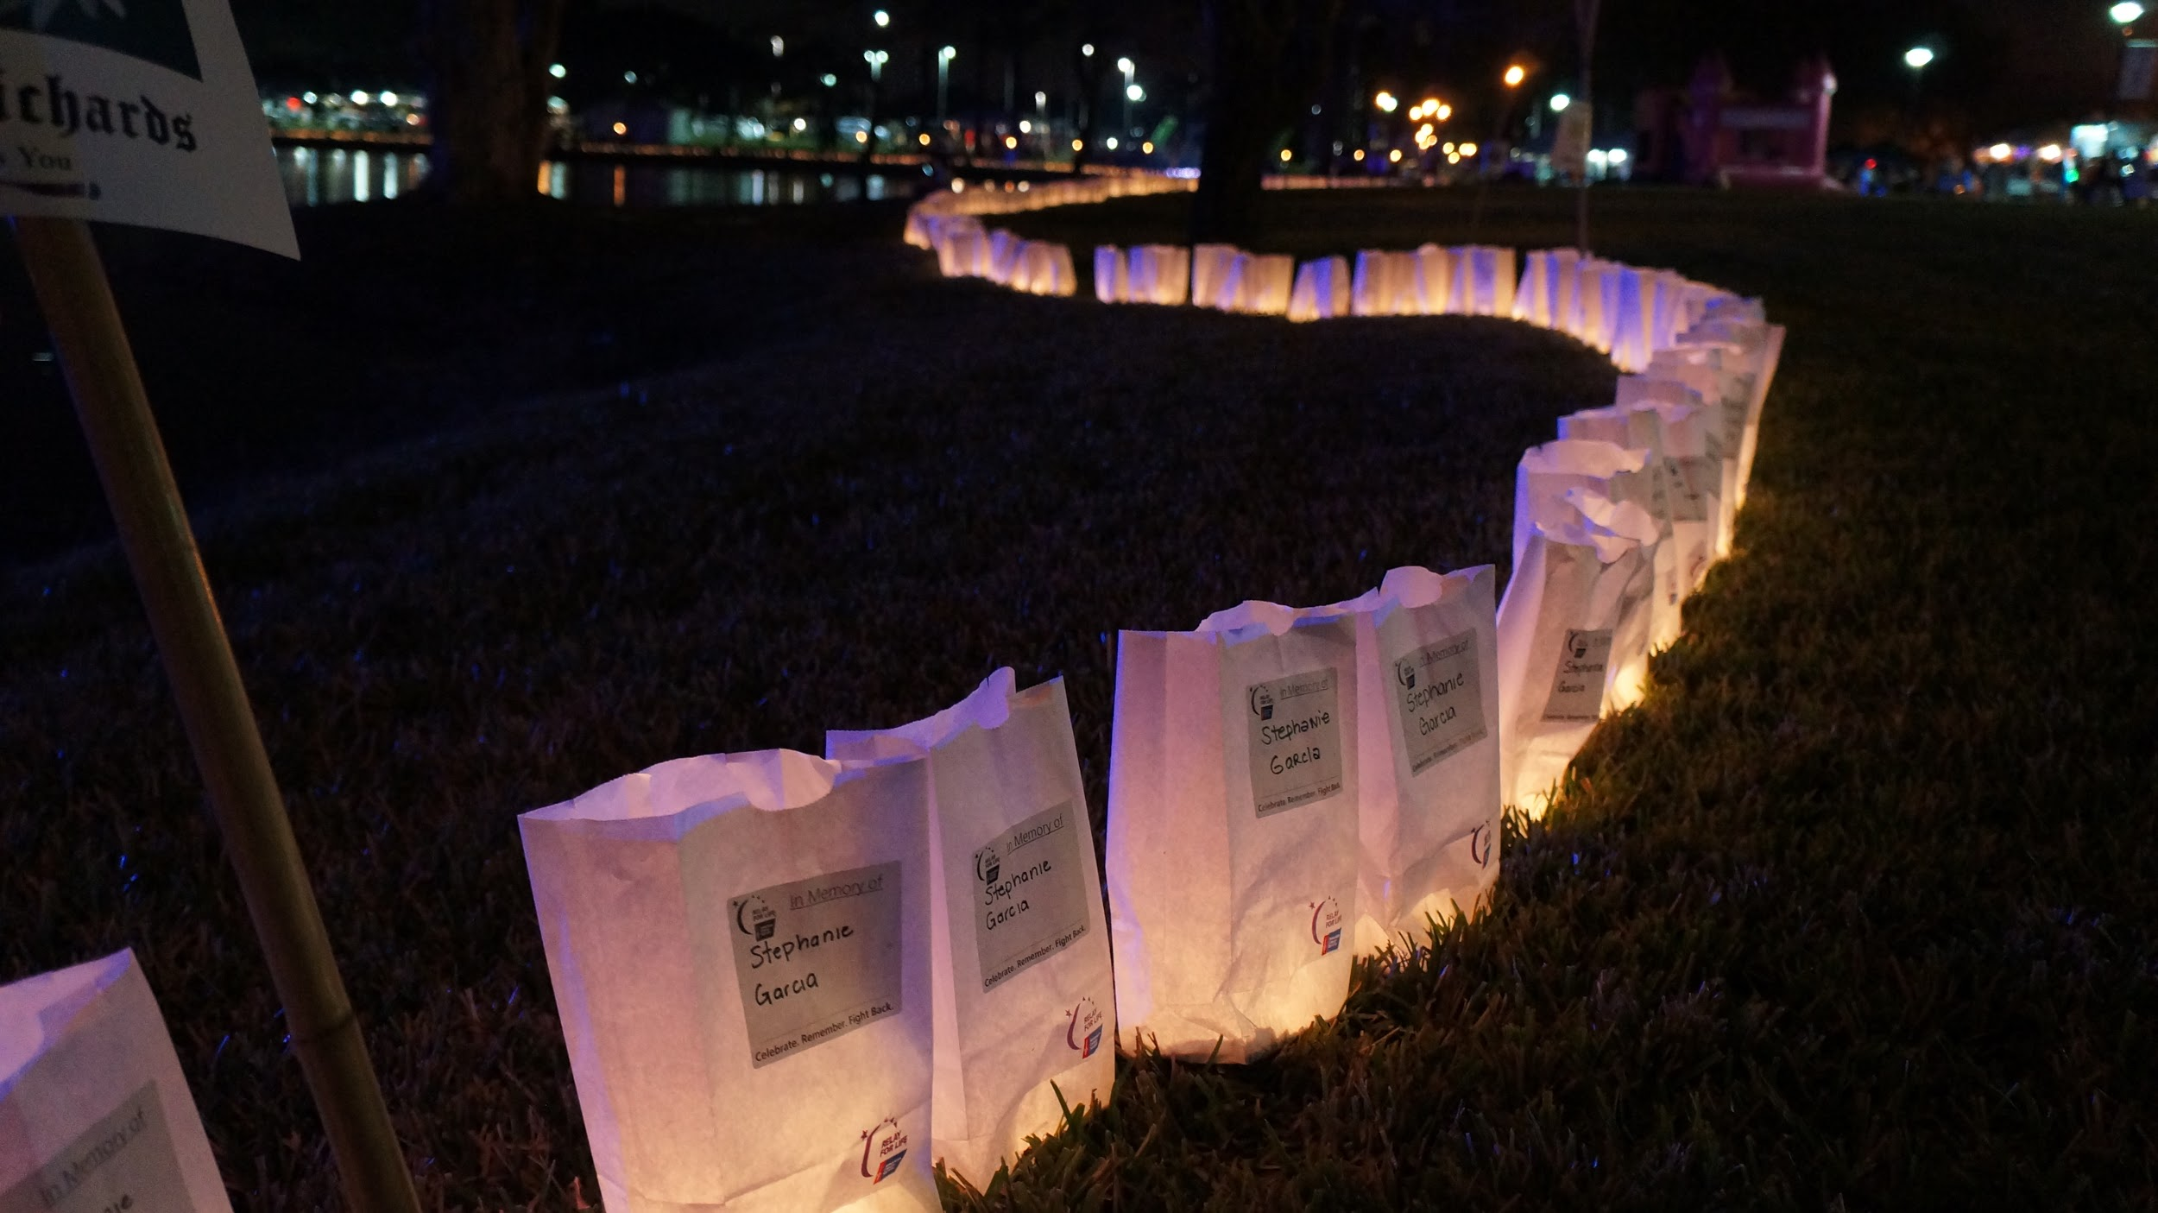
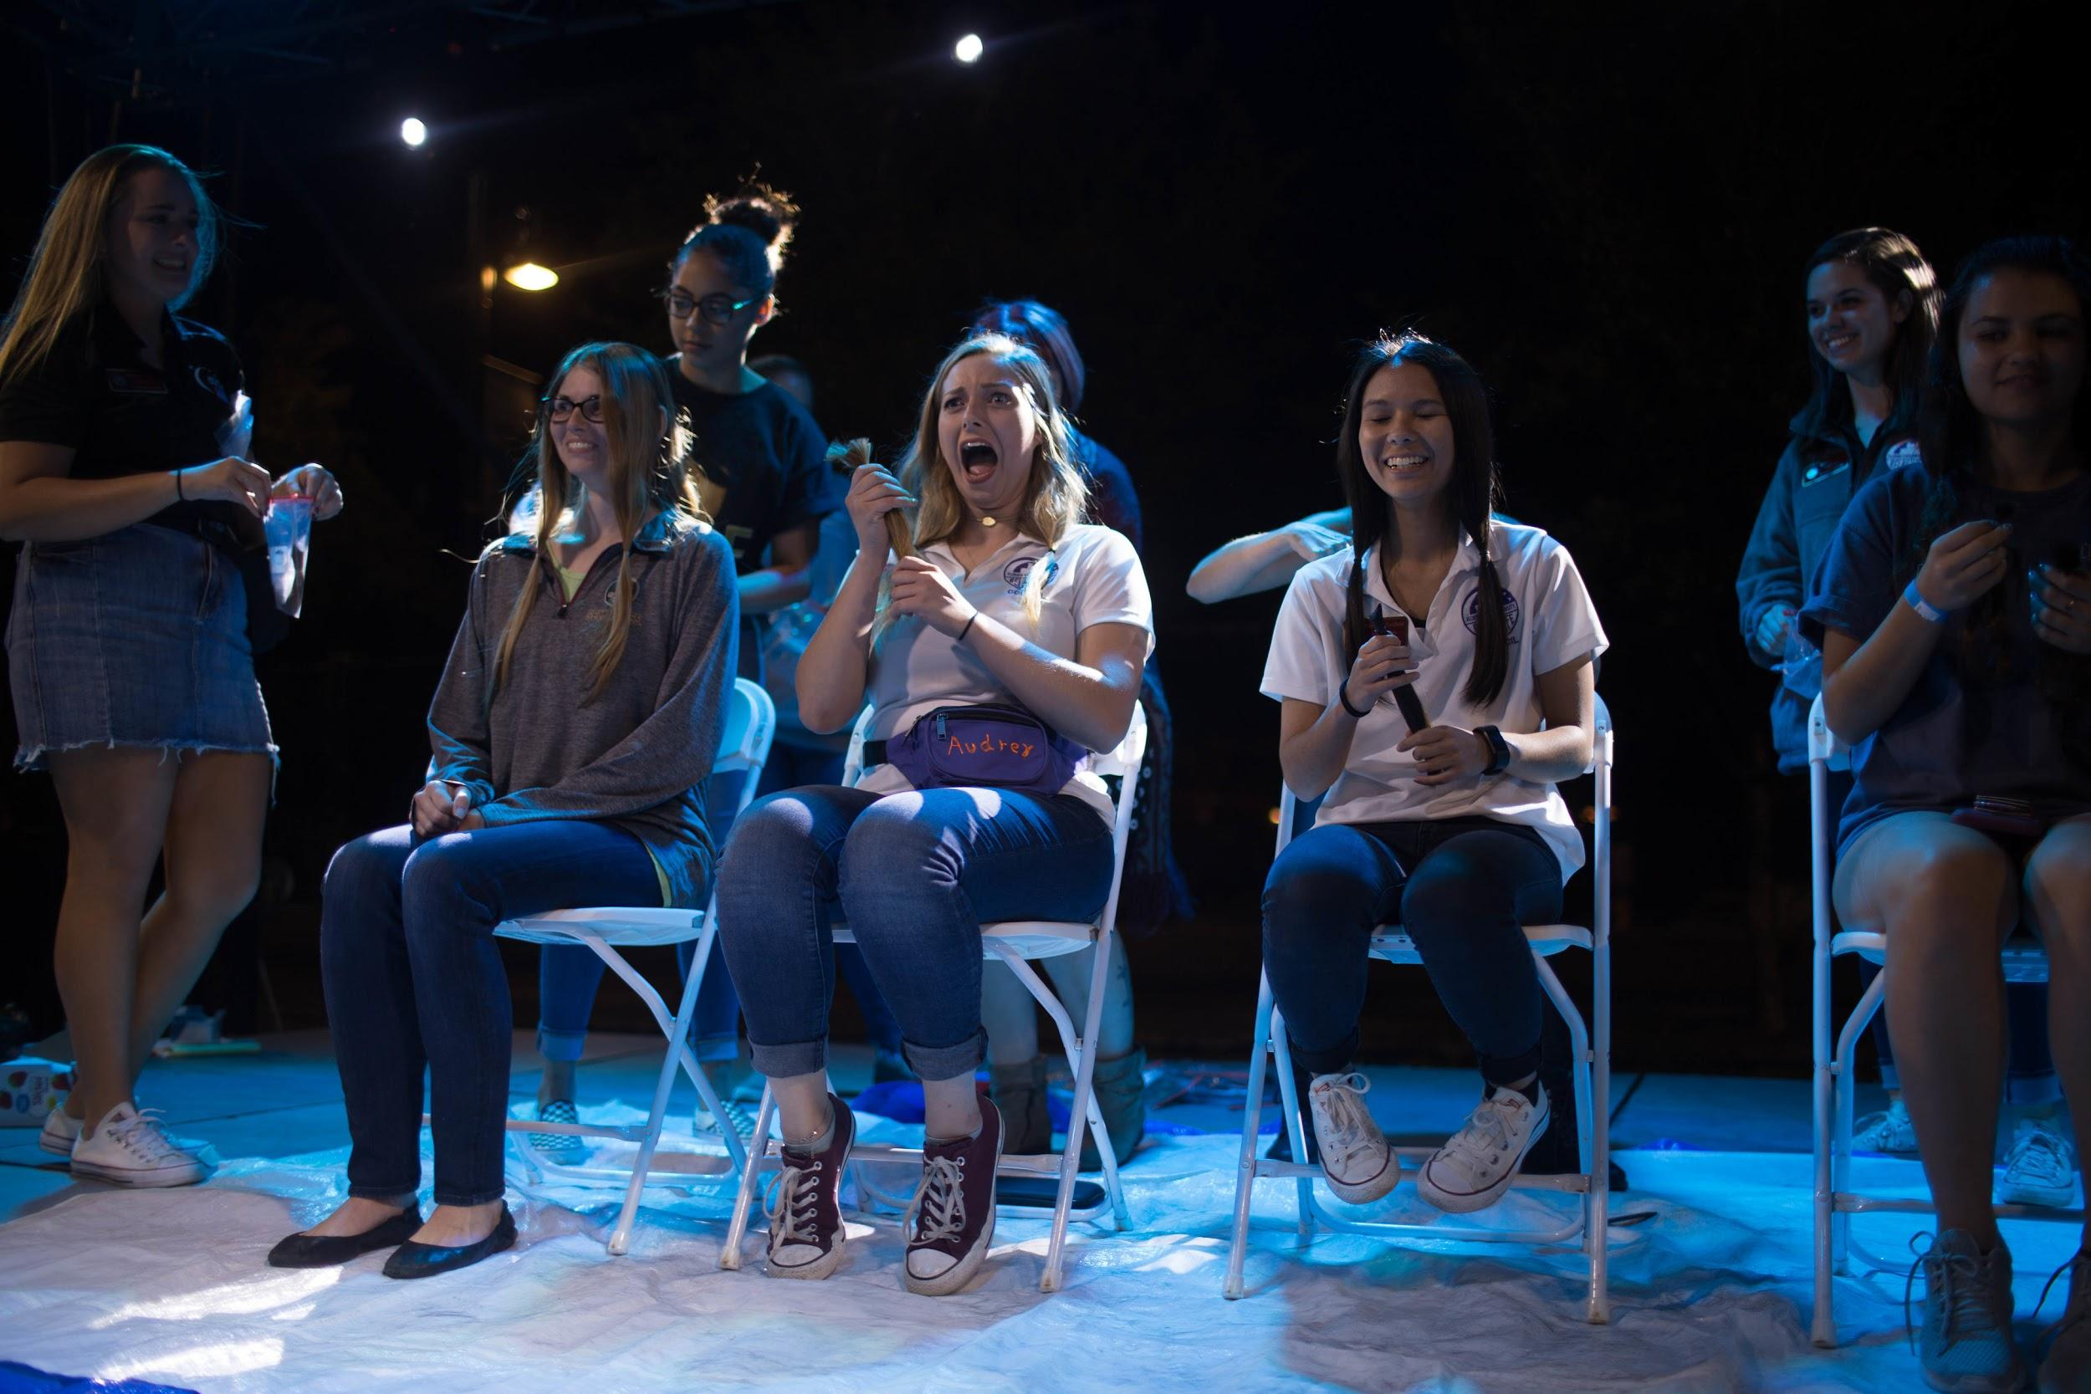
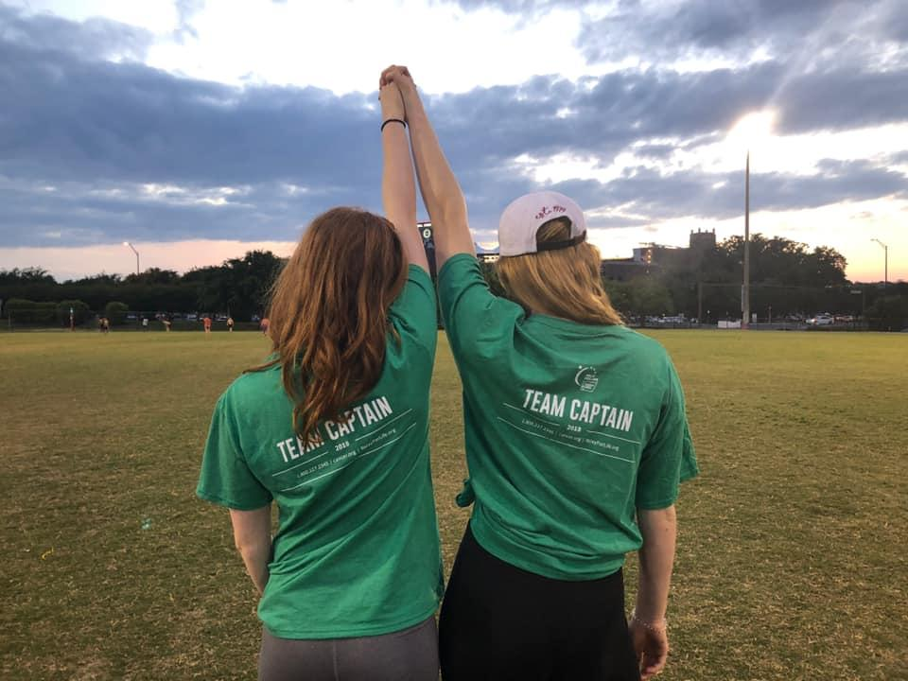
Relay For Life Schedule!
4pm- Team Captains arrive at the Old IM Fields
6pm- Opening Ceremonies
8:30pm- Trivia Tournament
11pm-12am- Luminaria Ceremony
12:15am- Women’s Haircutting
1:30am- Men’s Head Shaving
2am- Fight Back Ceremony
4am- Lip Sync Battle 2019
6:45am- Sunrise Yoga
8:30am- Closing Ceremonies
Notes:
schedule- alyssa

Slide 9
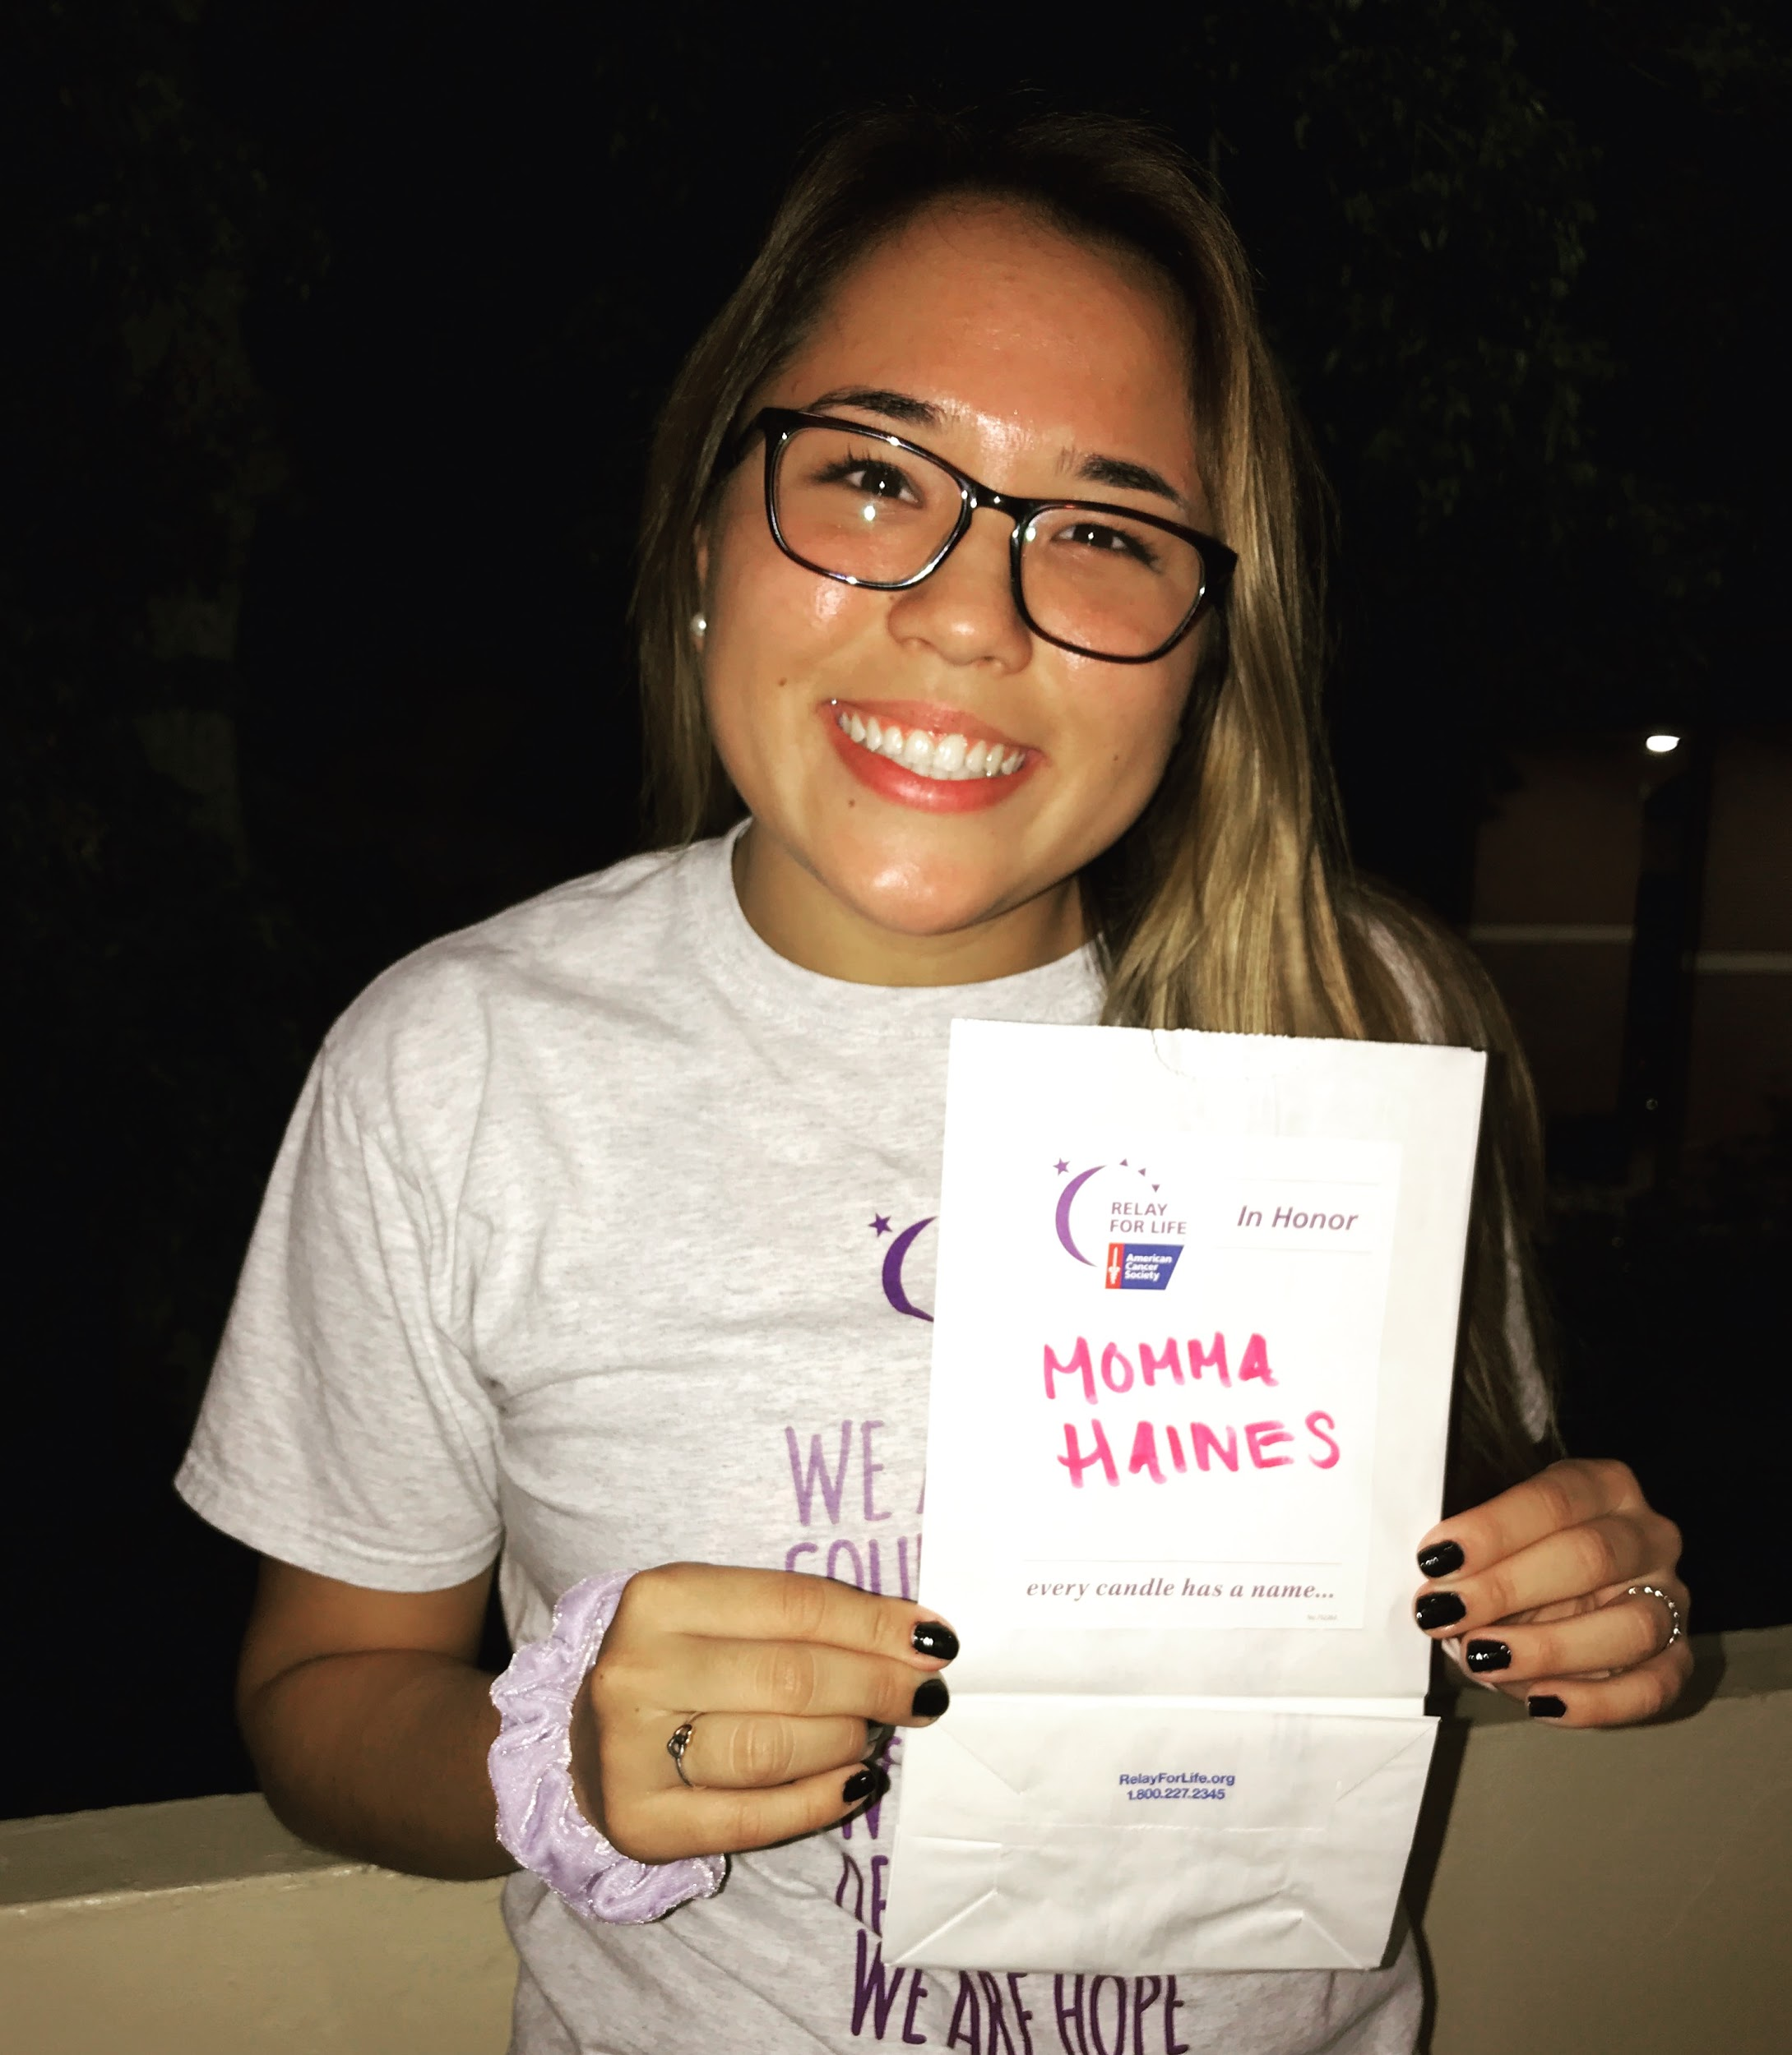
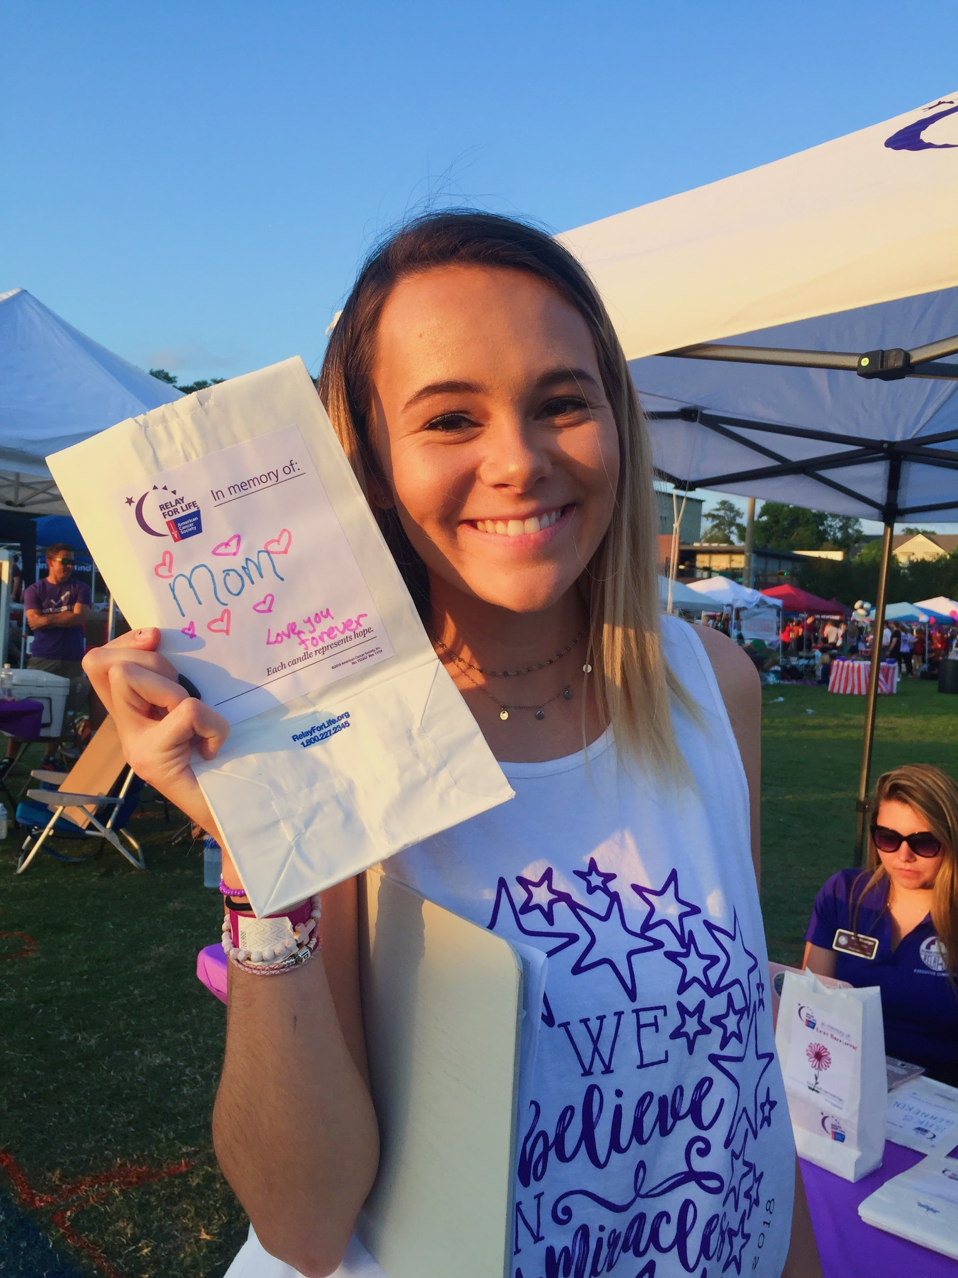
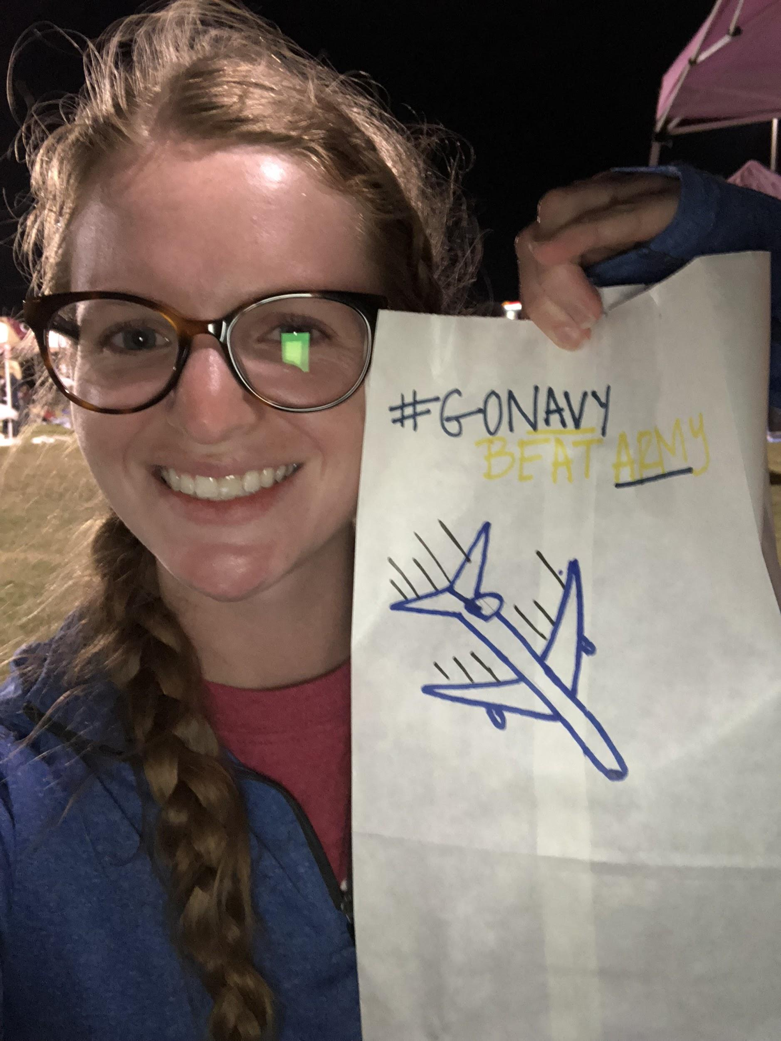
Luminaria Ceremony
A ceremony to remember loved ones who have lost their battle to cancer and honor those who are still fighting
NEW TIME: 11pm-12am
Guest Speakers:
Kunal Patel
Hannah Sandifer
Deb Botta
Slideshow to follow, if you would like your loved one to be featured in the slideshow, email fsurelayforlife.luminariachair@gmail.com
Notes:
luminarai- alyssa

Slide 10
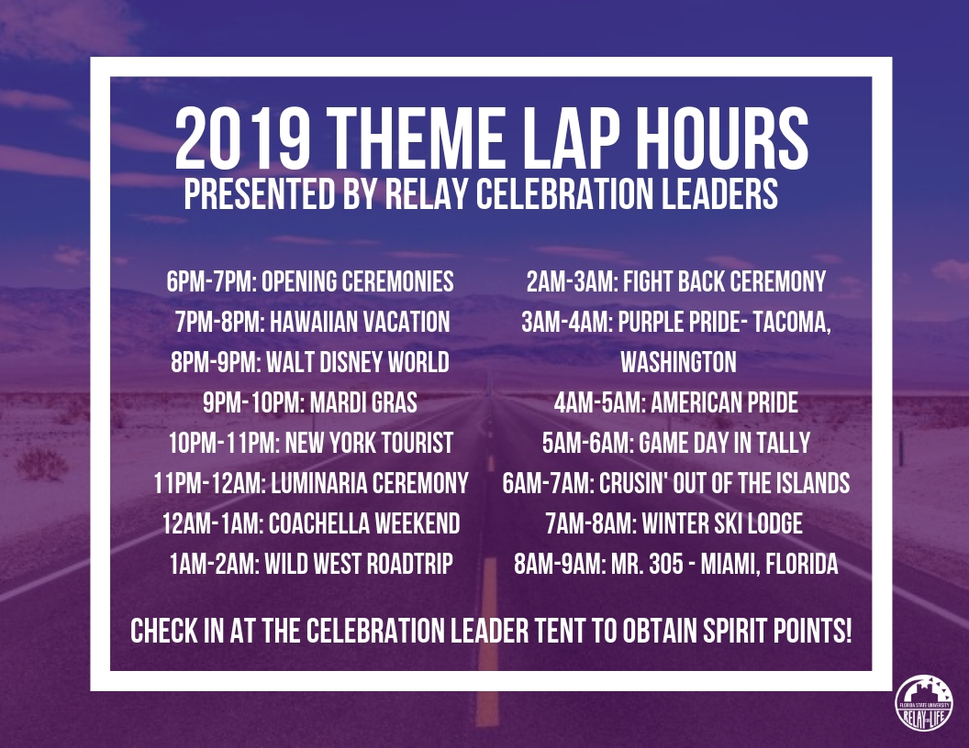
Theme Lap Hours
Notes:
theme laps- alyssa

Slide 11
What to Bring
Tailgate tent
Chairs
Tables
Cooler
Paper towels (you never know!)
Decorations for your campsite
Cards/board games
On-site fundraiser
Comfy shoes
Jacket & warm clothes
Theme lap outfits
Sunglasses
Hat
Umbrella & rain jacket (just in case)
Bug spray
Hand sanitizer
Sunscreen
Water
Money
Phone Charger
Spirit!
Notes:
what to bring- jillian

Slide 12
Final Checklist for Team Captains
Encourage your organization’s members to register for the event at relayforlife.org/fsufl
Email fsurfl.logistics@gmail.com to reserve your campsite location and theme idea
https://docs.google.com/spreadsheets/d/1szGl-qWHRmaCz0LZuZRPk0Z2vBGWpr5xjXTKnV-MmiE/edit?usp=sharing
Finalize your plans for night of:
What is your team selling?
Are you ordering t-shirts?
How will you encourage your members to fundraise all night?
How will you be collecting money during the night?
NEW! Relay For Life of FSU will be providing Venmos for your teams to use throughout the night.
For team campsites: @rflcampsites
For merchandise: @rflmerch
For on-stage activities: @rflstage
Notes:
tc final check and track intro - sam

Slide 13
Final Fundraising Pushes
Current Fundraising as of 10:37am on March 27, 2019: $140,339.54
How much further do we have to go? How are we going to get there?
$164,660.46 away from $305,000
What does this mean for teams?
Currently: 116 teams
If each team recruits 6 new members, we bring in $13,920
What does this mean for participants?
If each participant raises $20 before our event, we bring in: $42,000
In addition to current fundraising, our total grand total would be $266,996.64
If each participant raises $50 before our event, we bring in: $105,000
In addition to current fundraising, our total grand total would be $329,996.64
If each participant raises $100 before our event, we bring in: $210,000
In addition to current fundraising, our total grand total would be $434,996.64
Notes:
Brooke
$20→ one free ride to treatment
How do you make $20?
Charge $5 uber fee for 4 people this weekend
Skip Dunkin iced coffee 7 times
As 10 people for $2, or 2 people for $10
$50 → a free night at the Hope Lodge
How do you make $50?
Ask 5 people for $10, or 10 people for $5
Make a challenge, for every $5 donated to me I will go one day without coffee
Make gifts for $5 (pottery, crafts)
$100 → one patient with 24/7 peer support on their diagnosis and treatment
How do you make $100?
Ask 10 people for $10
Mom, dad, grandma, grandpa, aunt, uncle, school teacher, roommate, roommate’s parent, sibling
Venmo request 50 people $2

Slide 14
Fundraising Ideas
Share your fundraising dashboard on social media
Share your Why I Relay story with potential donors
Send individual texts, emails, and letters to friends and family
Ask EVERYONE for donations- even professors!
Offer incentives for reaching your fundraising goals
Jump in Wescott
Post embarrassing photos/videos of yourself
Give up something you enjoy (like coffee) for a donation
Link your Facebook with your fundraising dashboard
Offer Relay rides this weekend
Use resources from Relay at FSU
Participate in online challenges by Relay at FSU
Notes:
heather

Slide 15
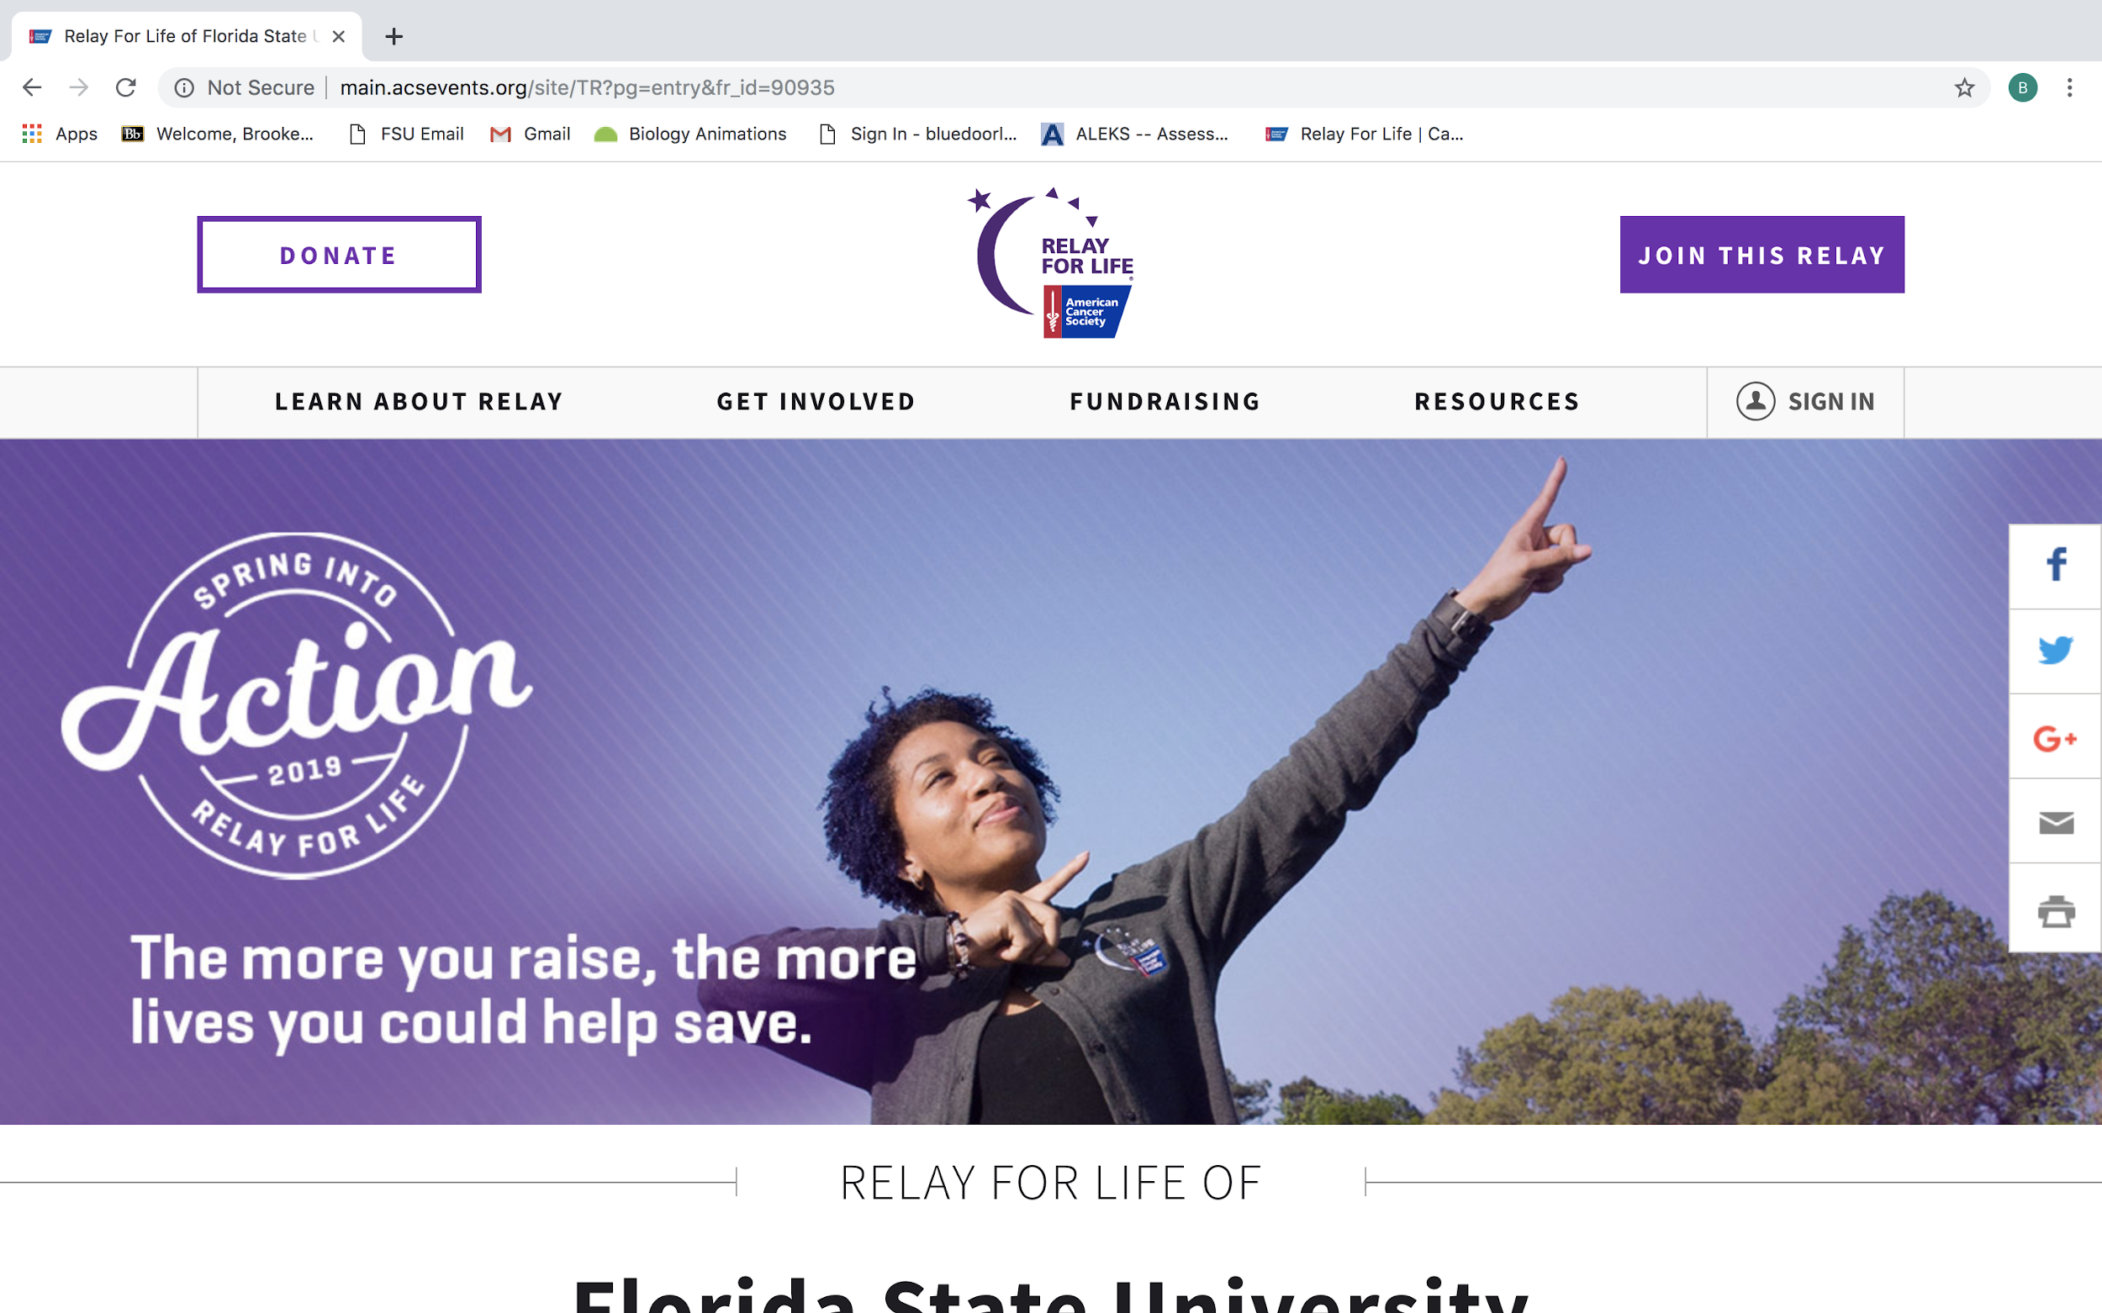
Connecting Your Facebook and Fundraising
Notes:
brooke

Slide 16
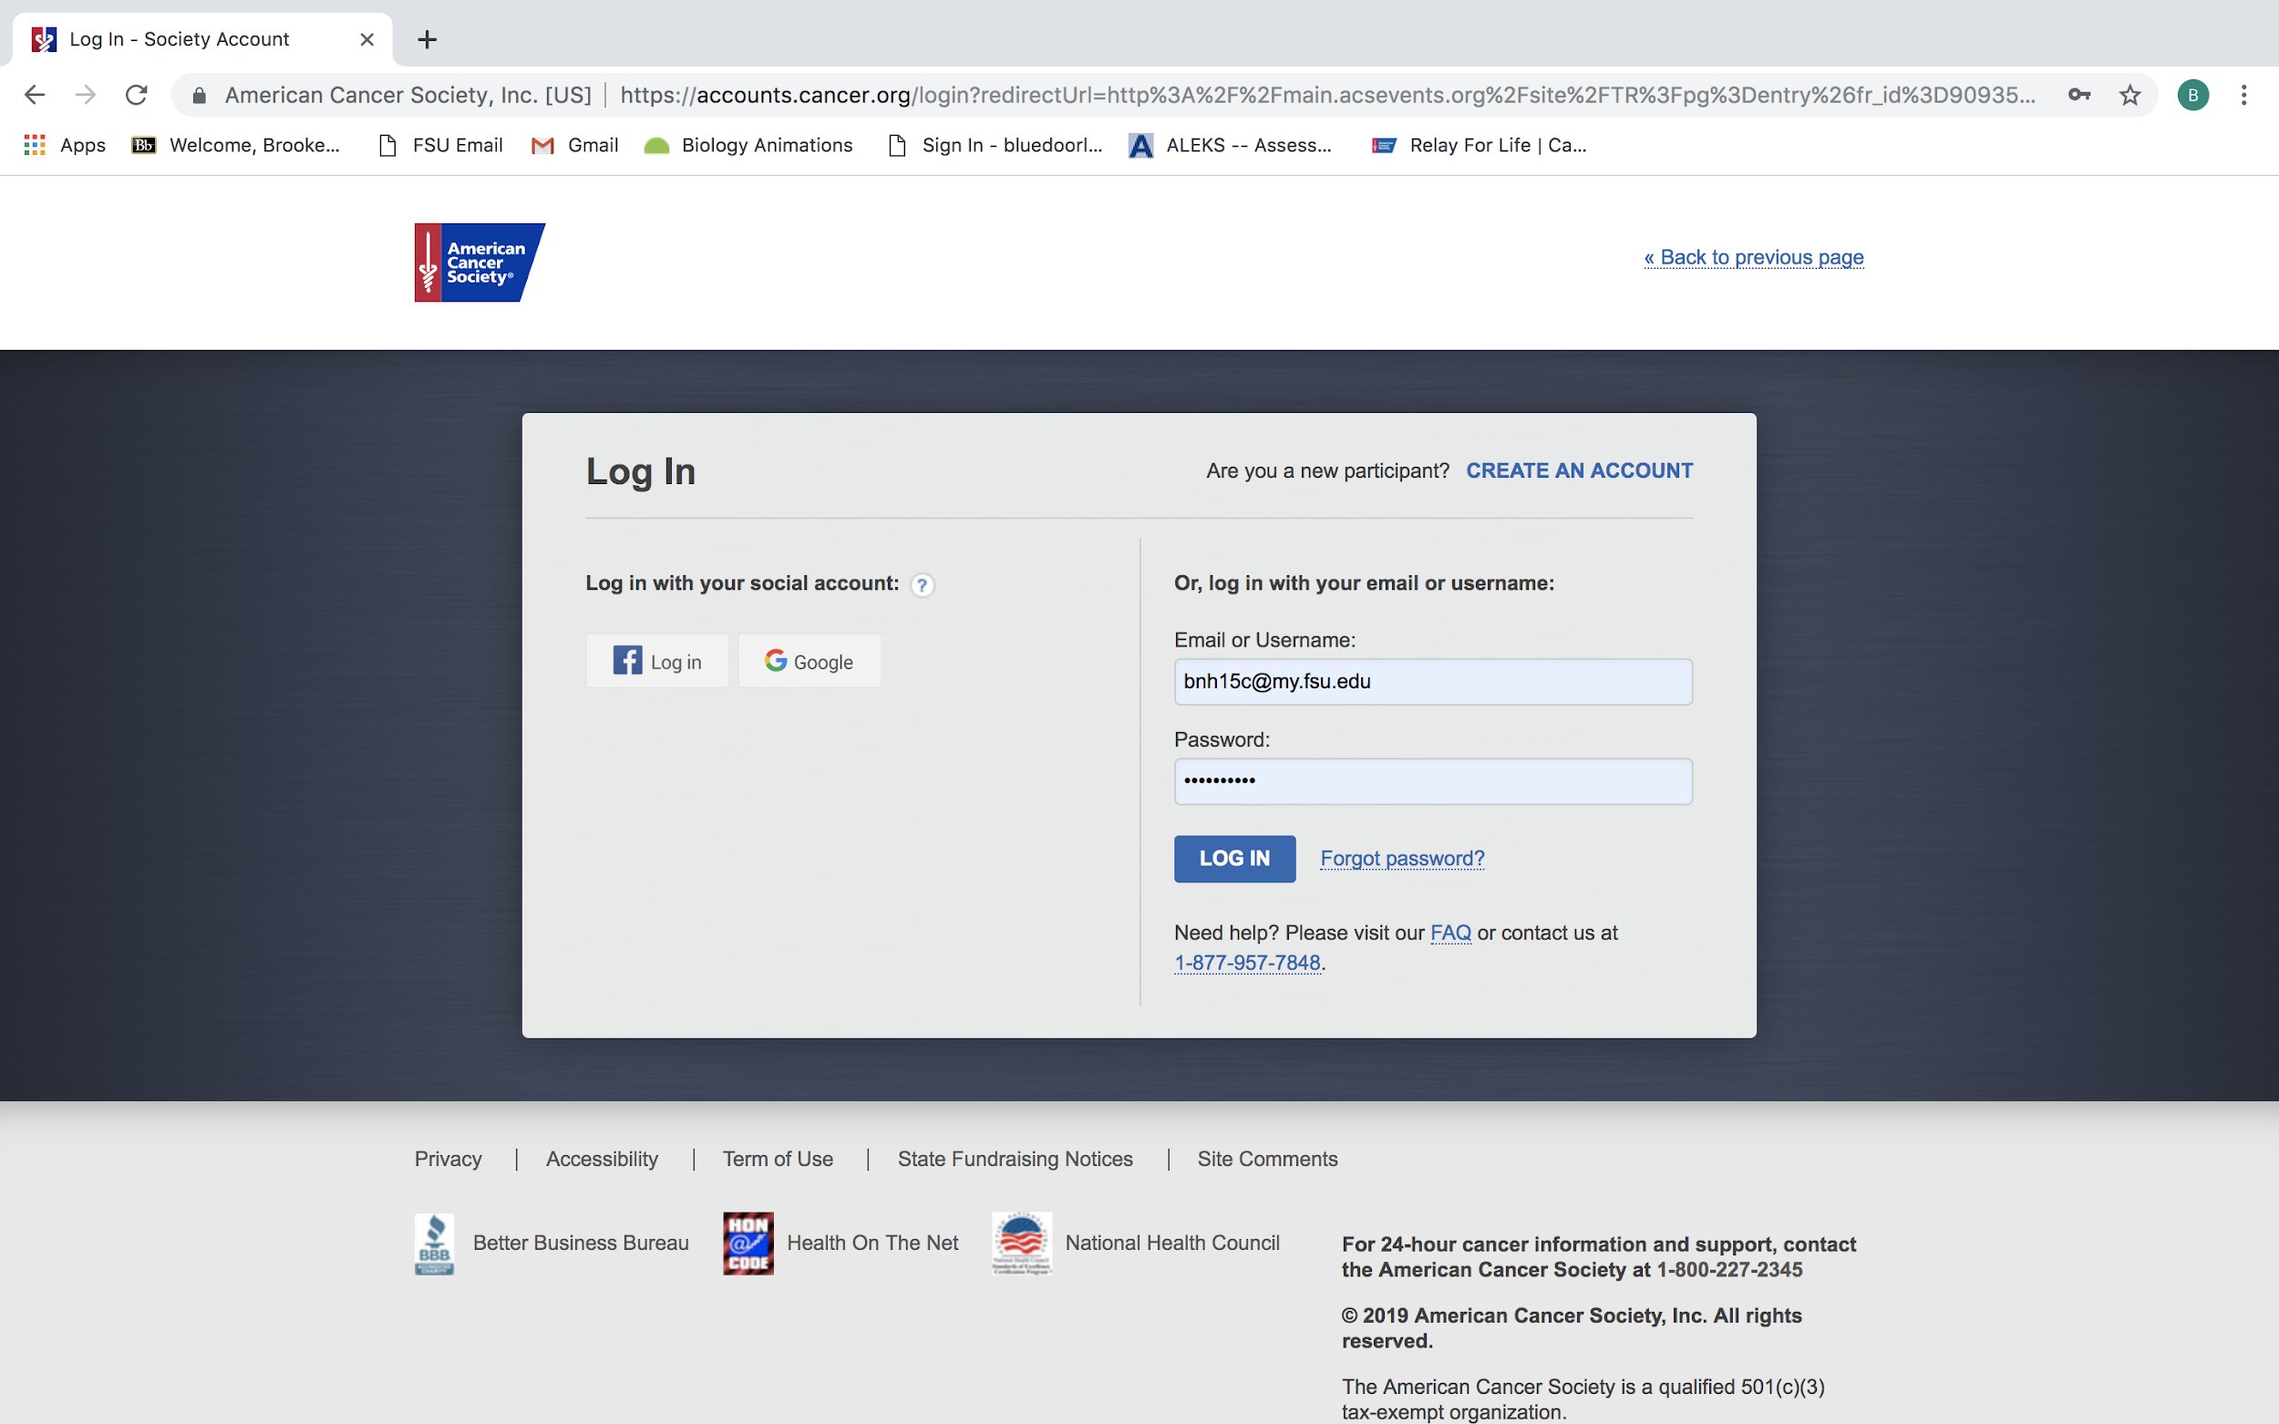
Connecting Your Facebook and Fundraising
Notes:
brooke

Slide 17
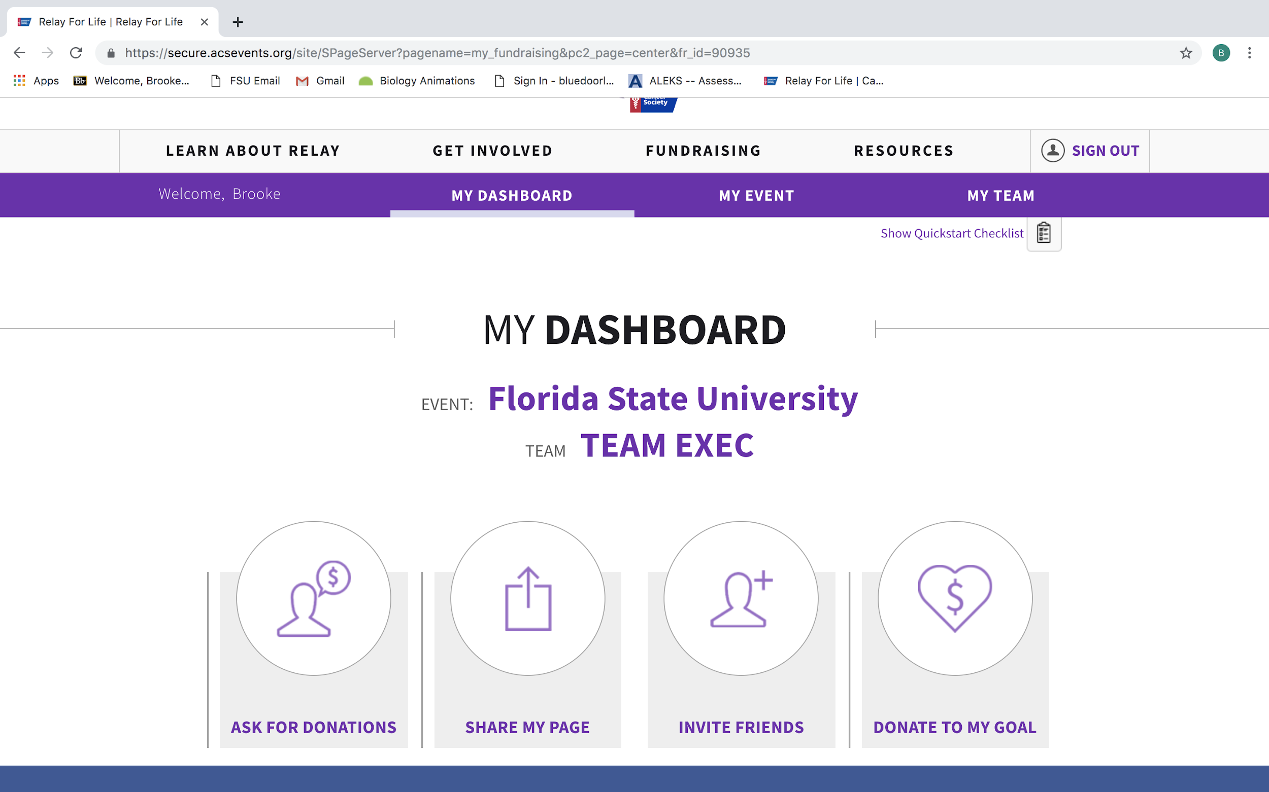
Connecting Your Facebook and Fundraising
Notes:
brooke

Slide 18
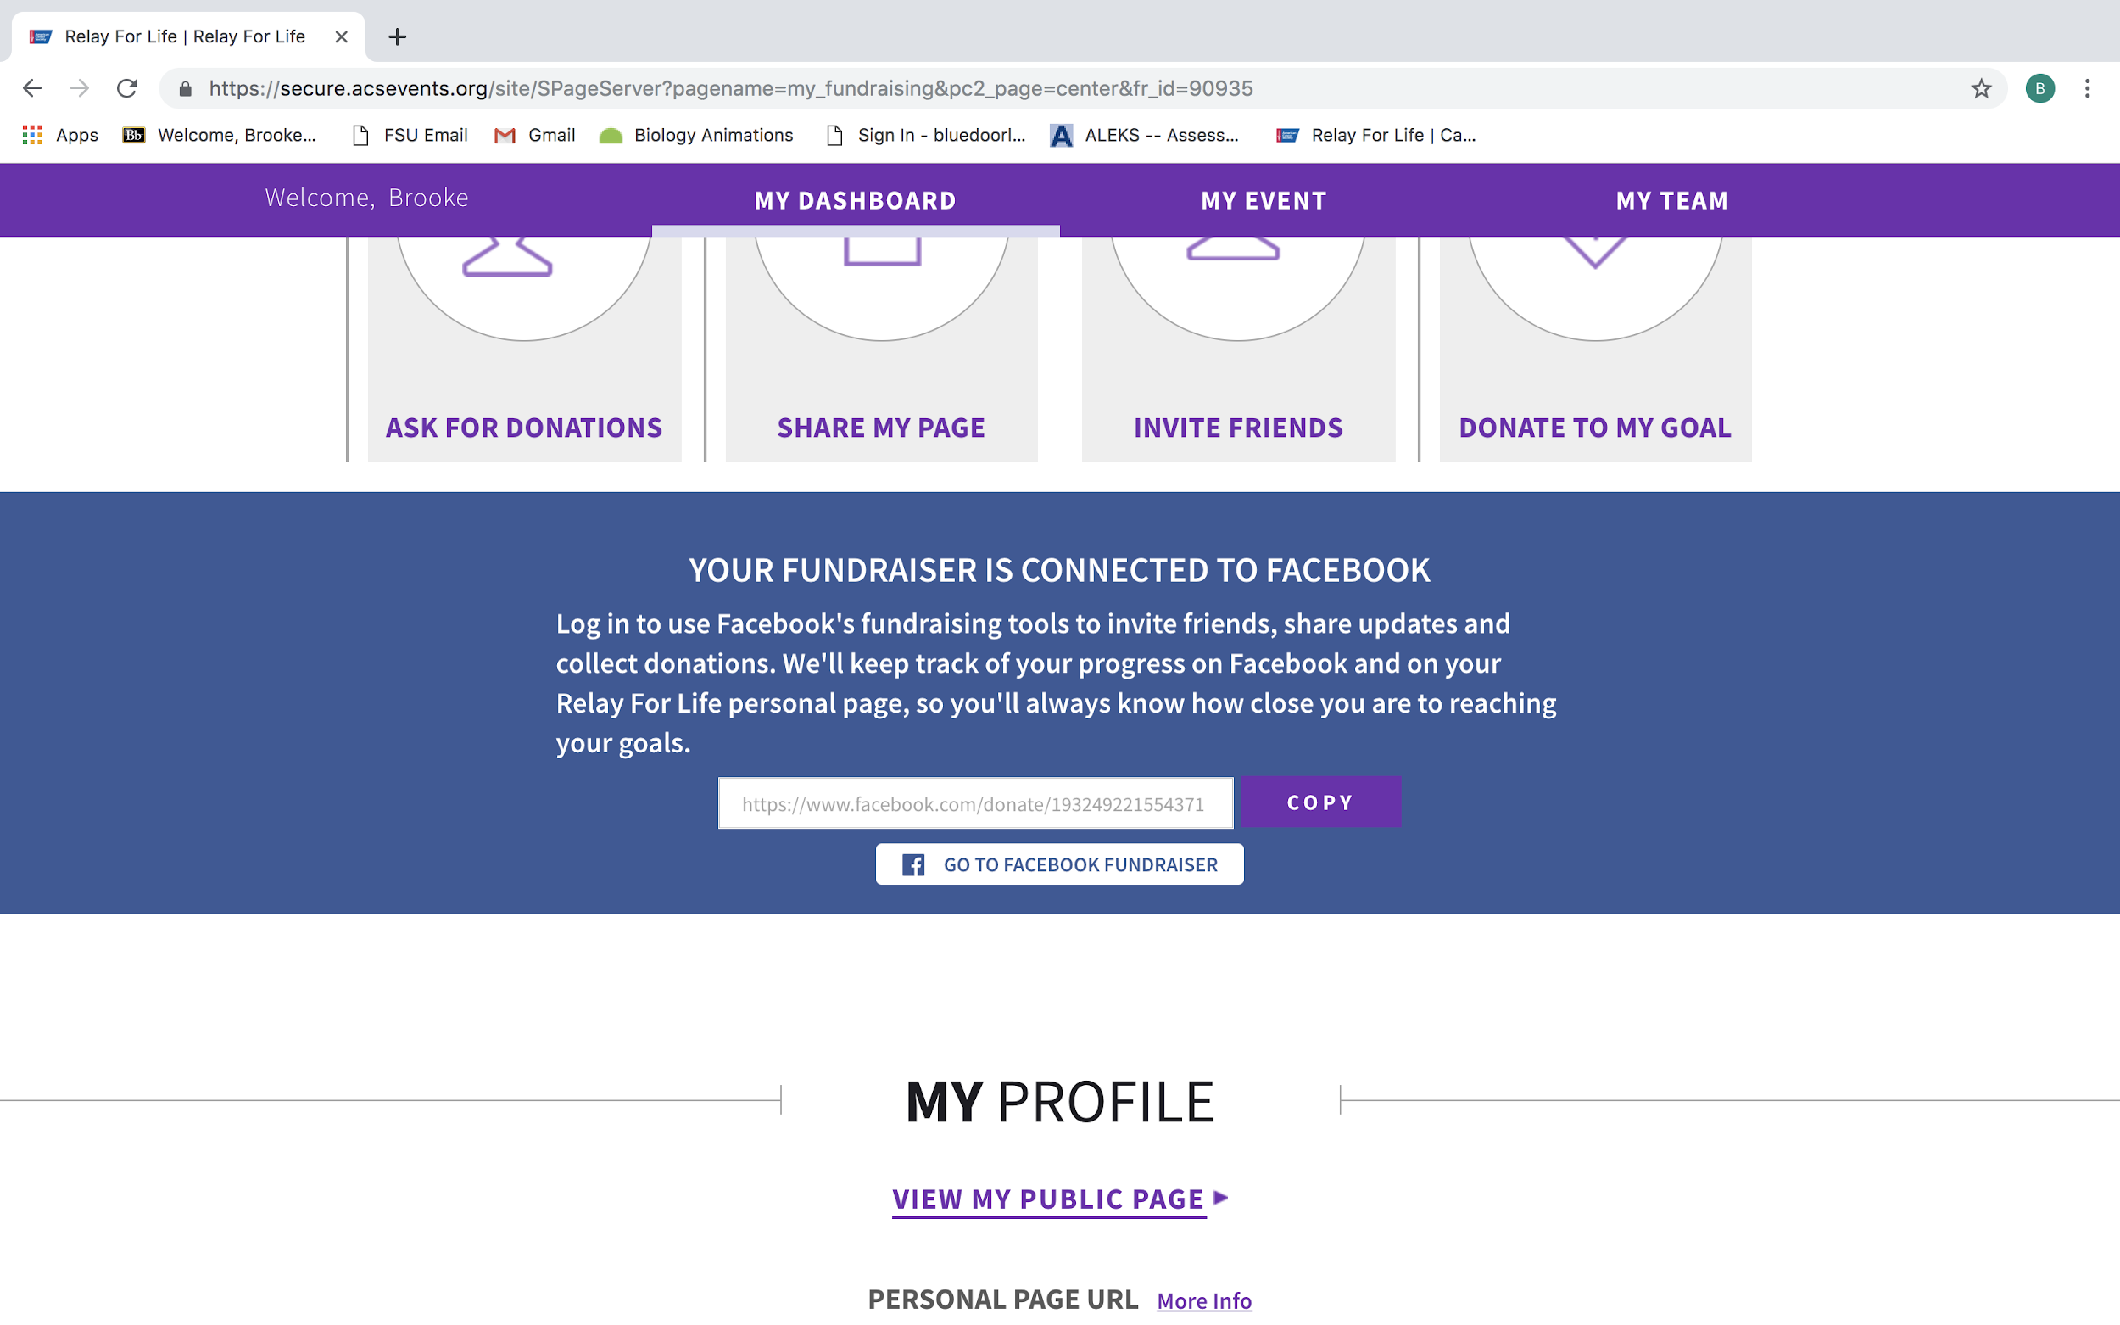
Connecting Your Facebook and Fundraising
Notes:
brooke

Slide 19
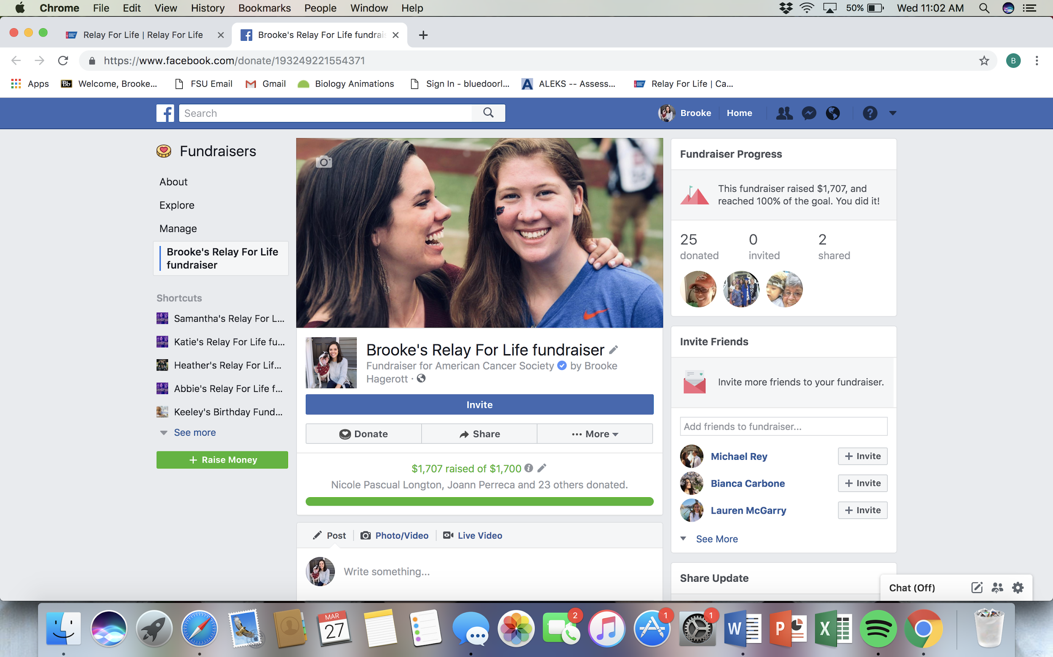
Connecting Your Facebook and Fundraising
Notes:
brooke

Slide 20


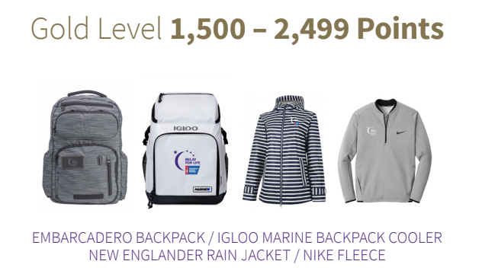
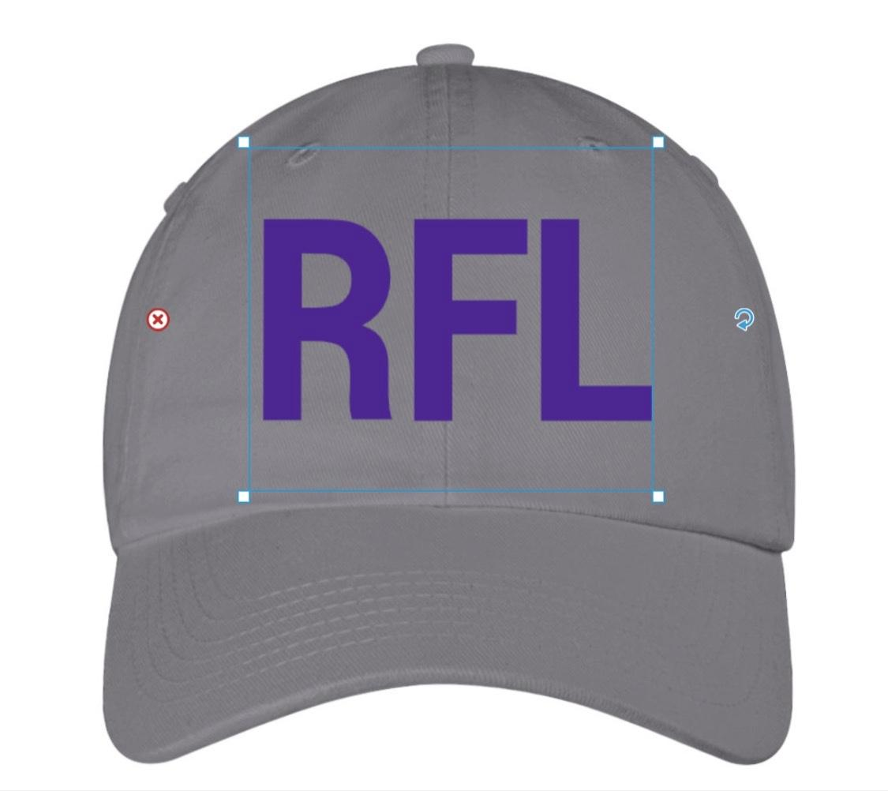
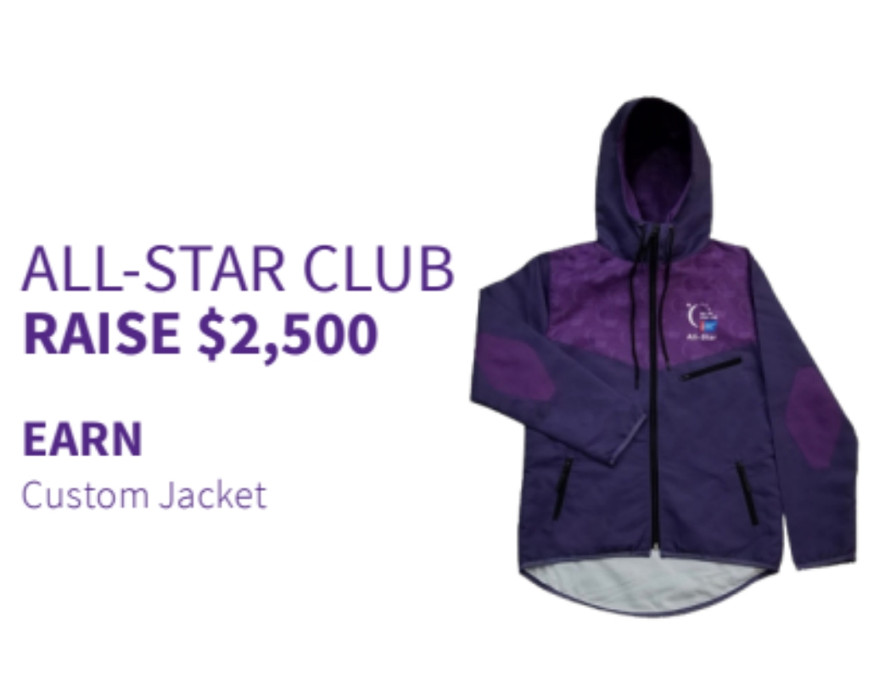

NEW! Fundraising Punch Card
New incentive for participants based on their yearlong fundraising efforts. Check in at the main event to receive your prizes .
$100- Hope Club t-shirt
$250- Relay merchandise
$500- VIP Club t-shirt
$750- Access to the Relay Chill Zone
$1,000- RFL Socks
$1,550- RFL Hat
Notes:
heather

Slide 21



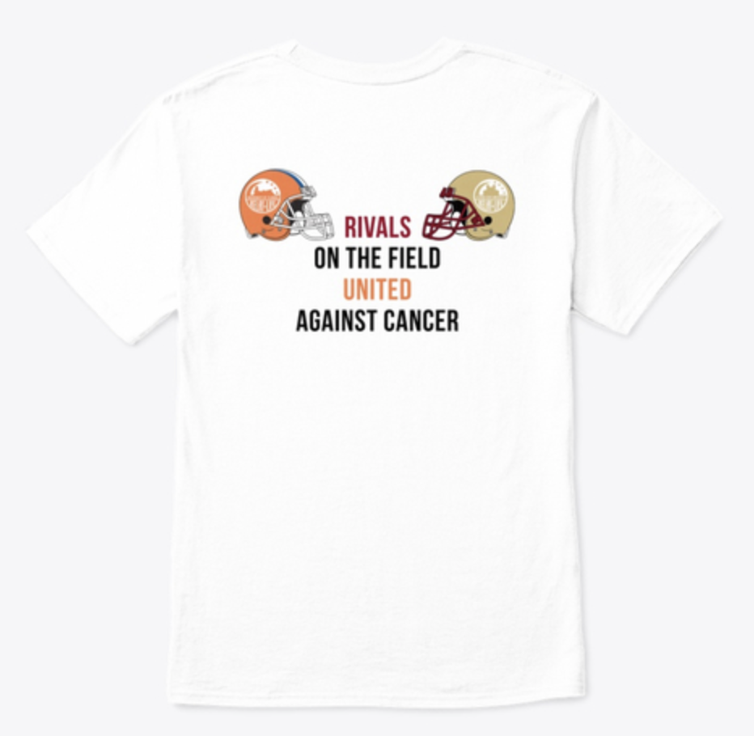
Purchase Relay Merchandise
https://teespring.com/stores/relaymerch?page=1
Notes:
sloane

Slide 22
Follow us on social media!
Facebook: Relay For Life of FSU
Instagram: @fsurelayforlife
Twitter: @fsurelayforlife
Sign up for our new texting system!
Text: RFL FSU
To: 69922
Notes:
sloane

